Slide 1
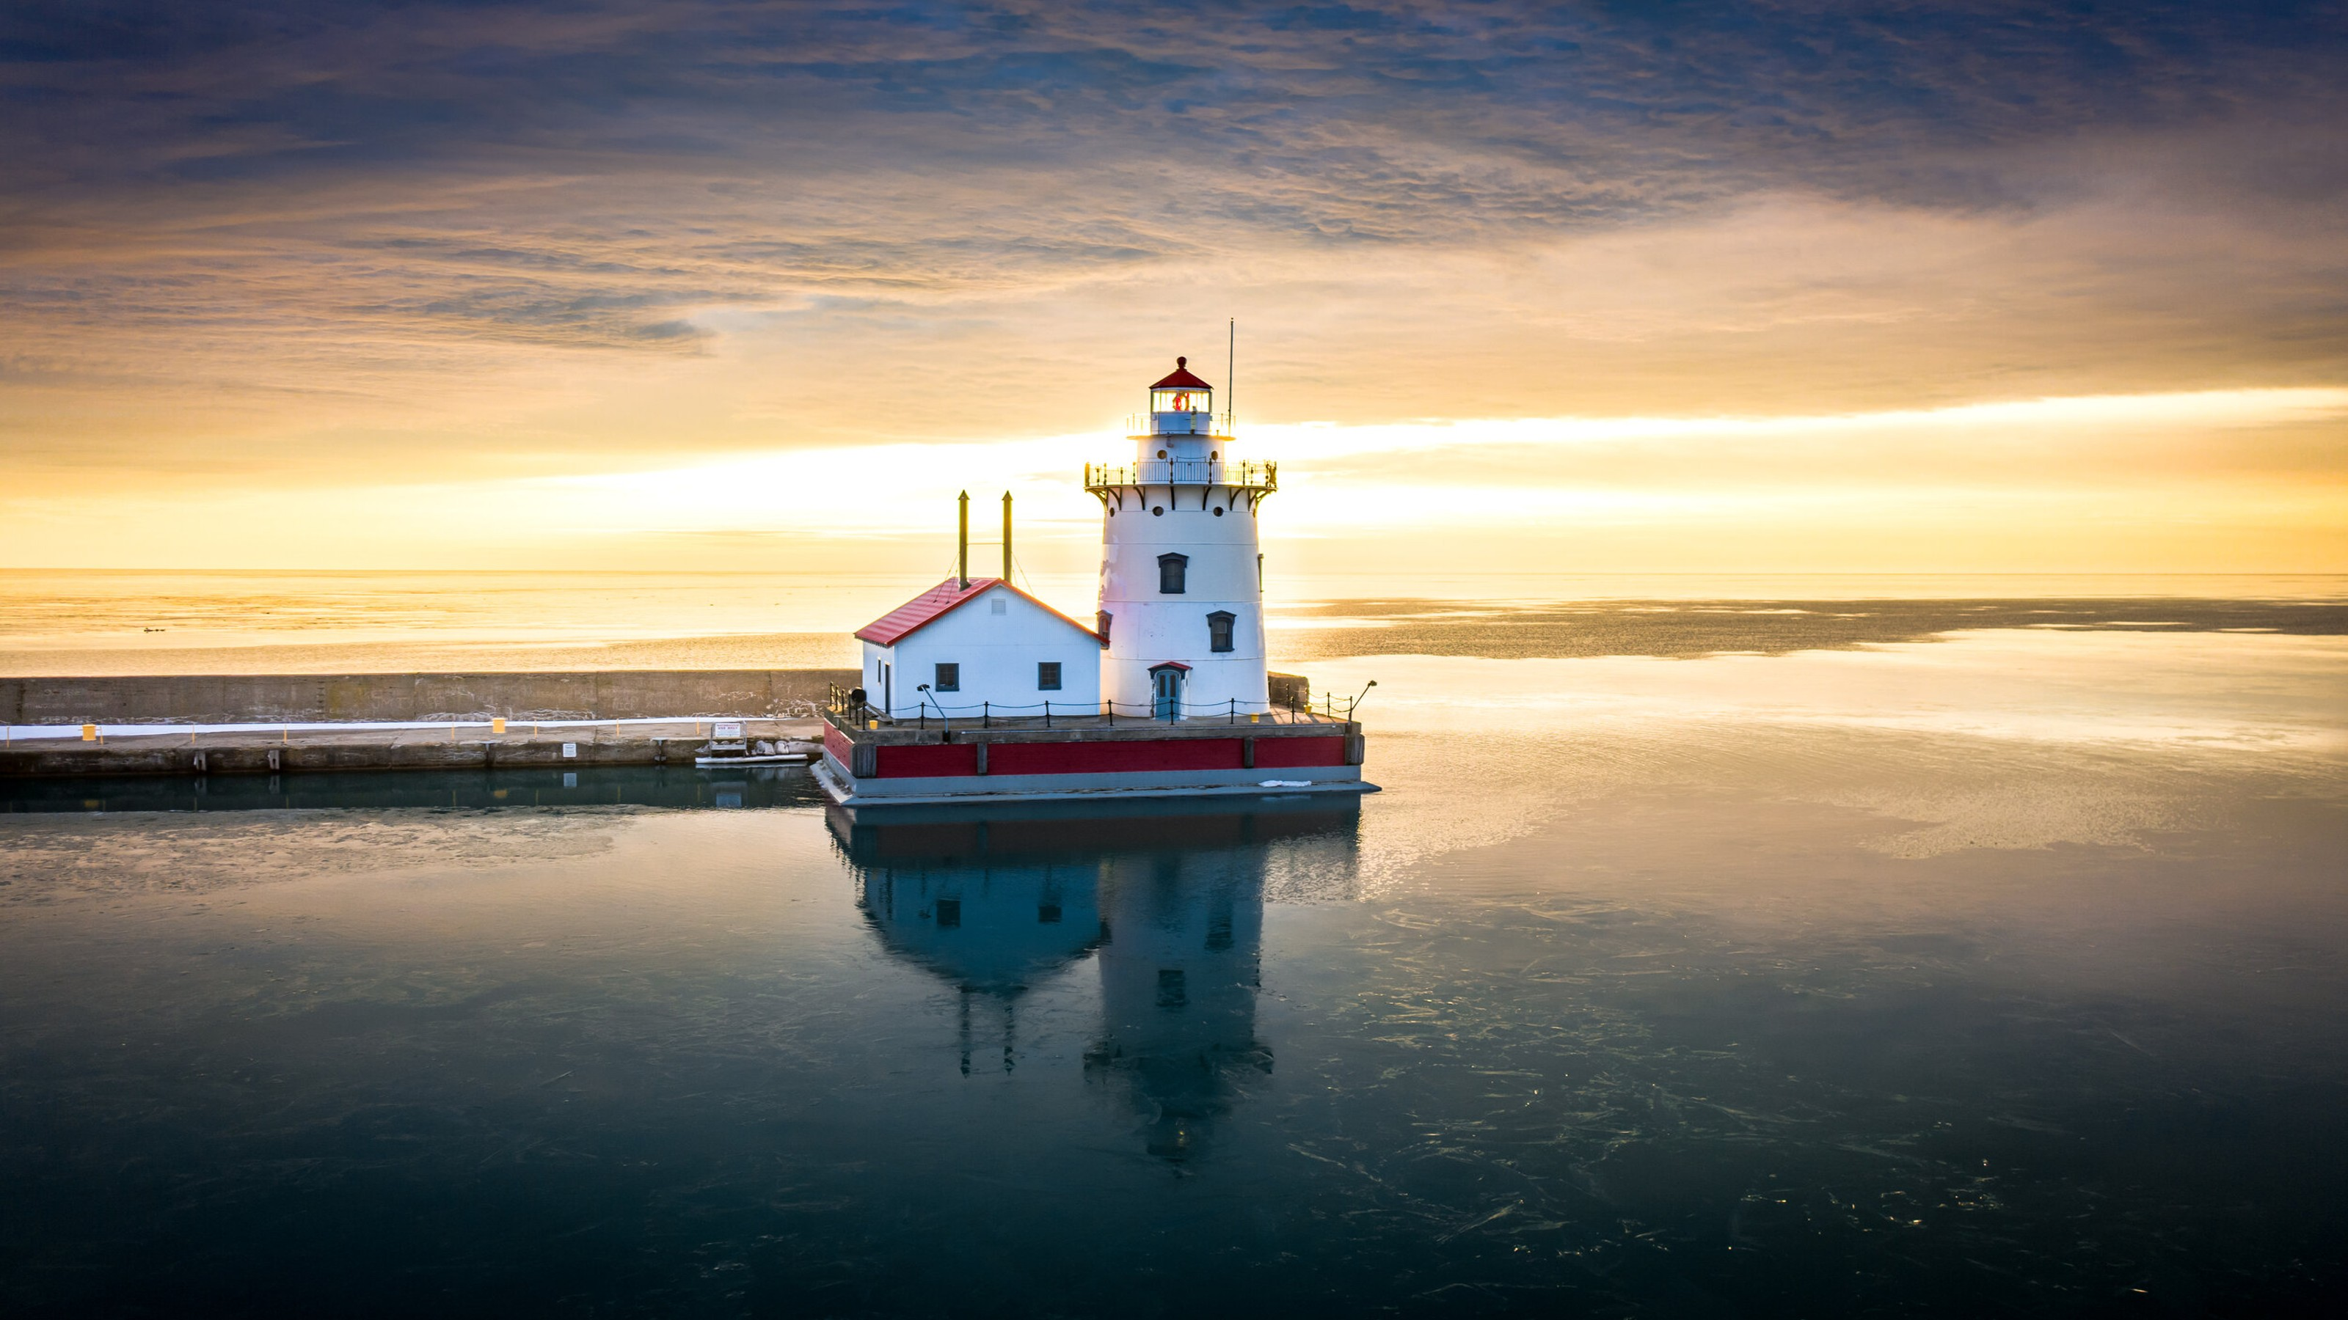
City of Harbor Beach

Slide 2
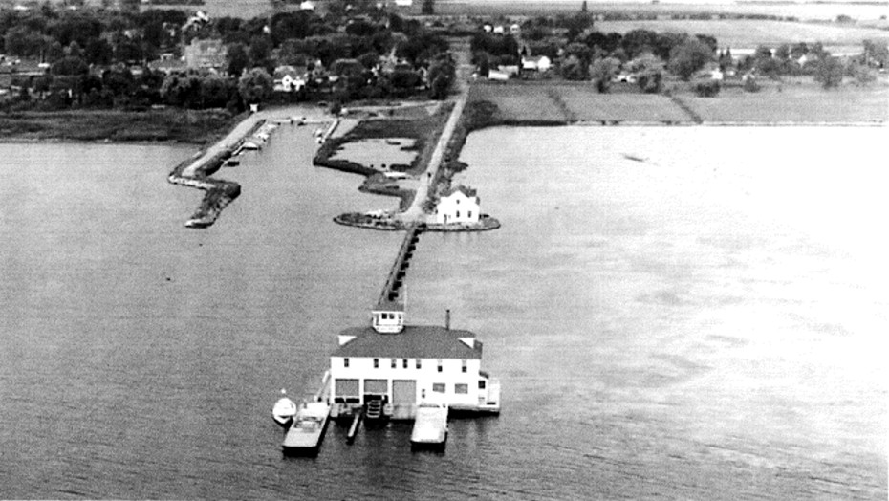
The Site for the “waterfront Enhancement Project” is a former Coast Guard Installation that was originally built on Pack street in the early 1930’s.

Slide 3
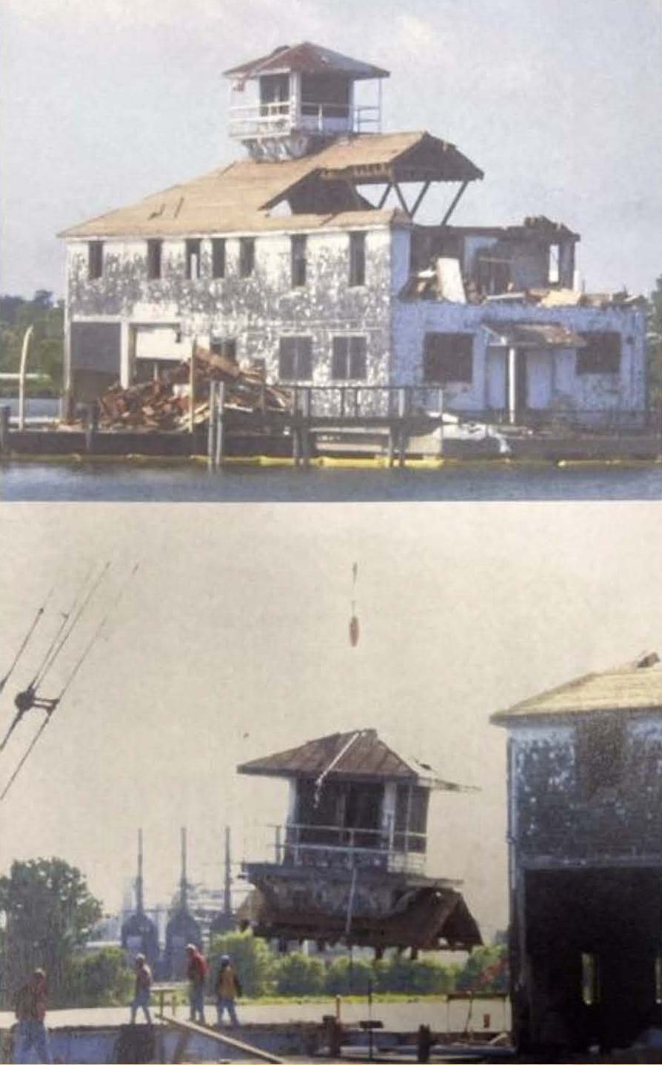
Old Coast guard station
A new Coast guard Station was built near the City’s marina. The facility on Pack Street was abandoned and eventually demolished.

Slide 4
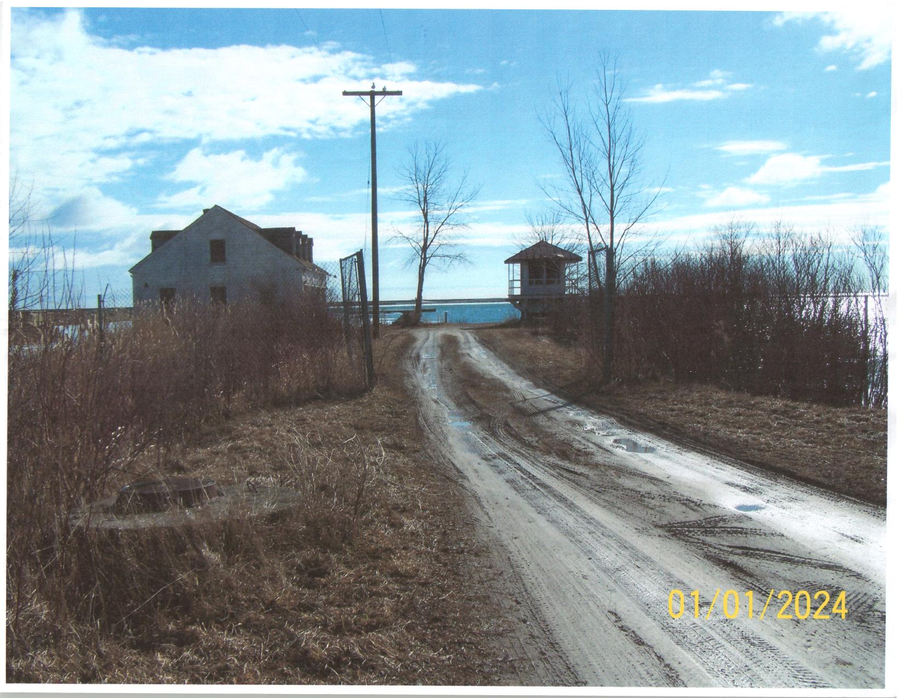
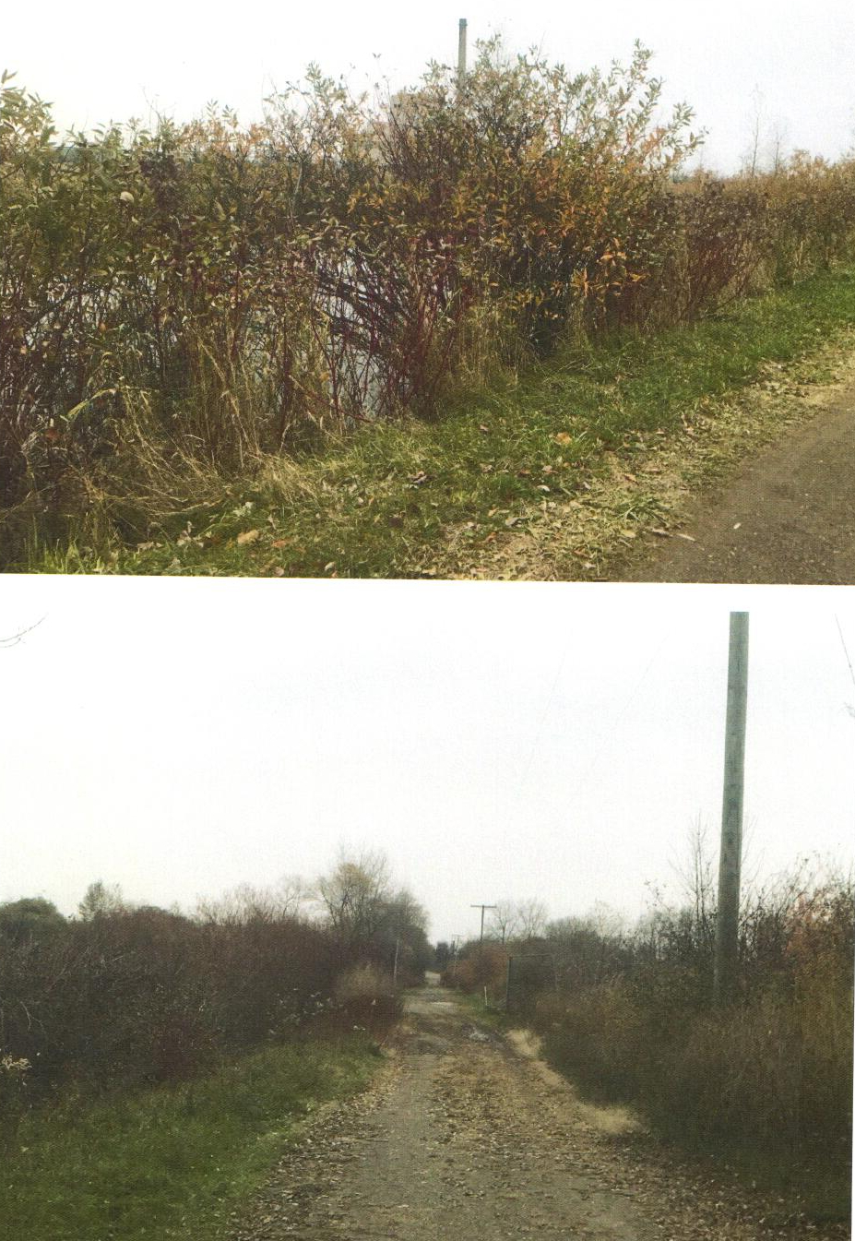
Property blight
The former Coast Guard Station site became one of City’s worst blighted areas.

Slide 5
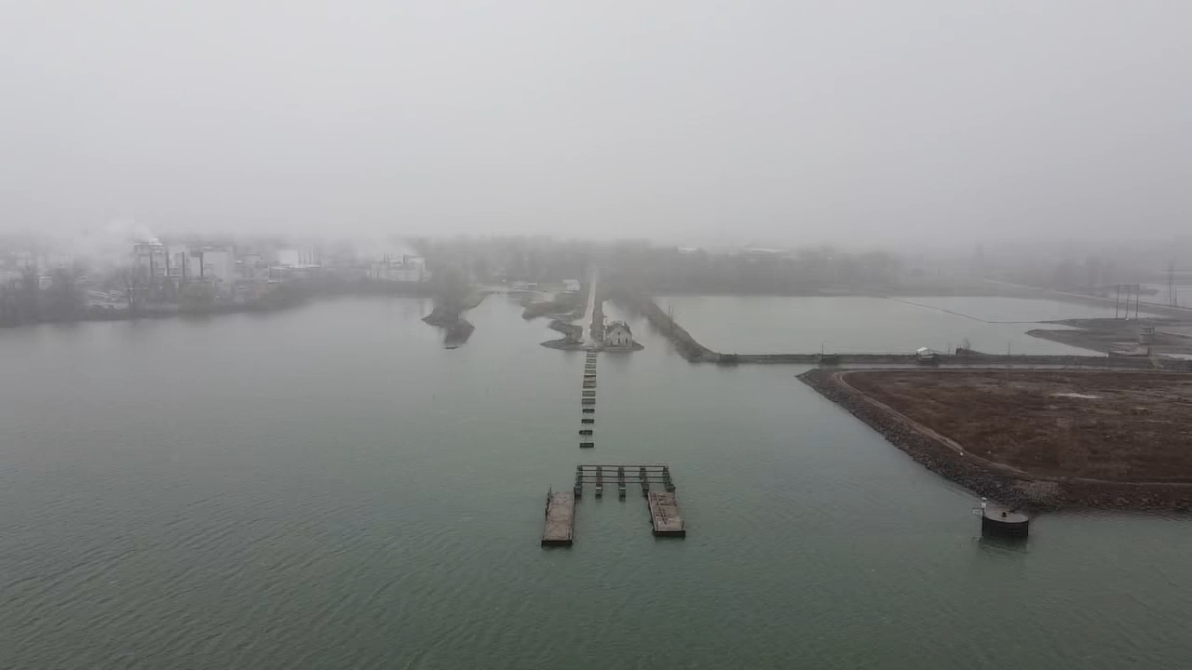
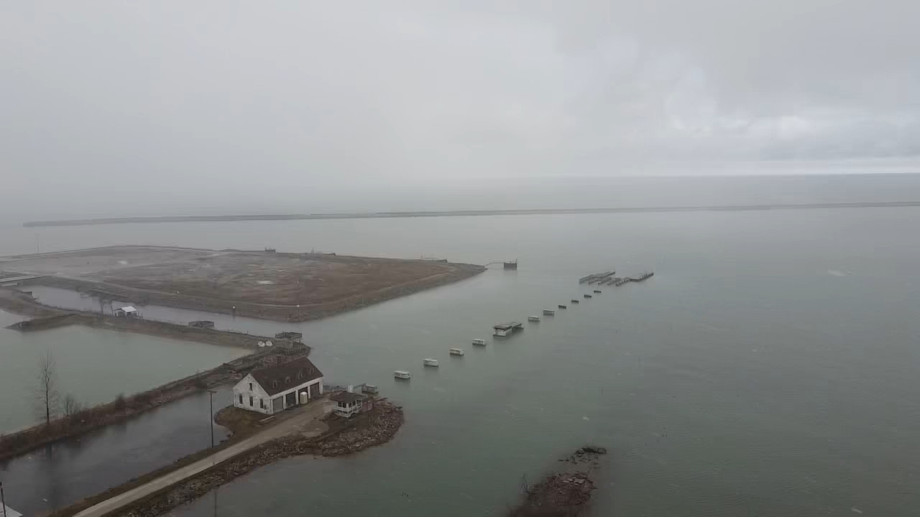
Funding secured
The City obtained the property from the GAS. In 2015 the City of Harbor Beach was awarded a grant from the Michigan DNR Trust Fund and received a donation from DTE to repurpose the site. Planning and the clean up effort began that same year.

Slide 6
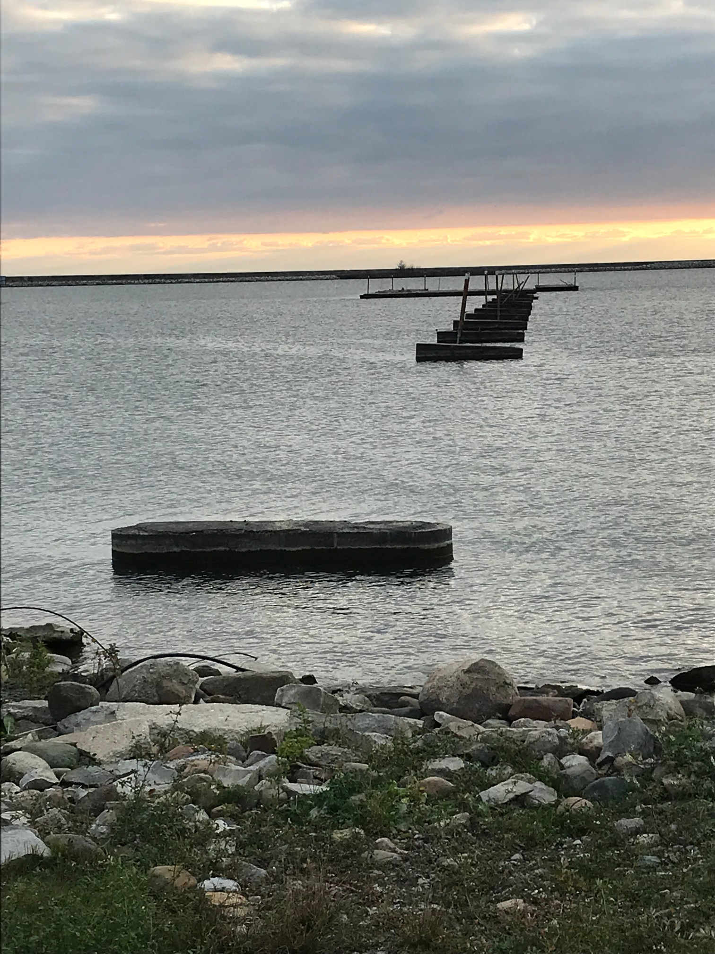
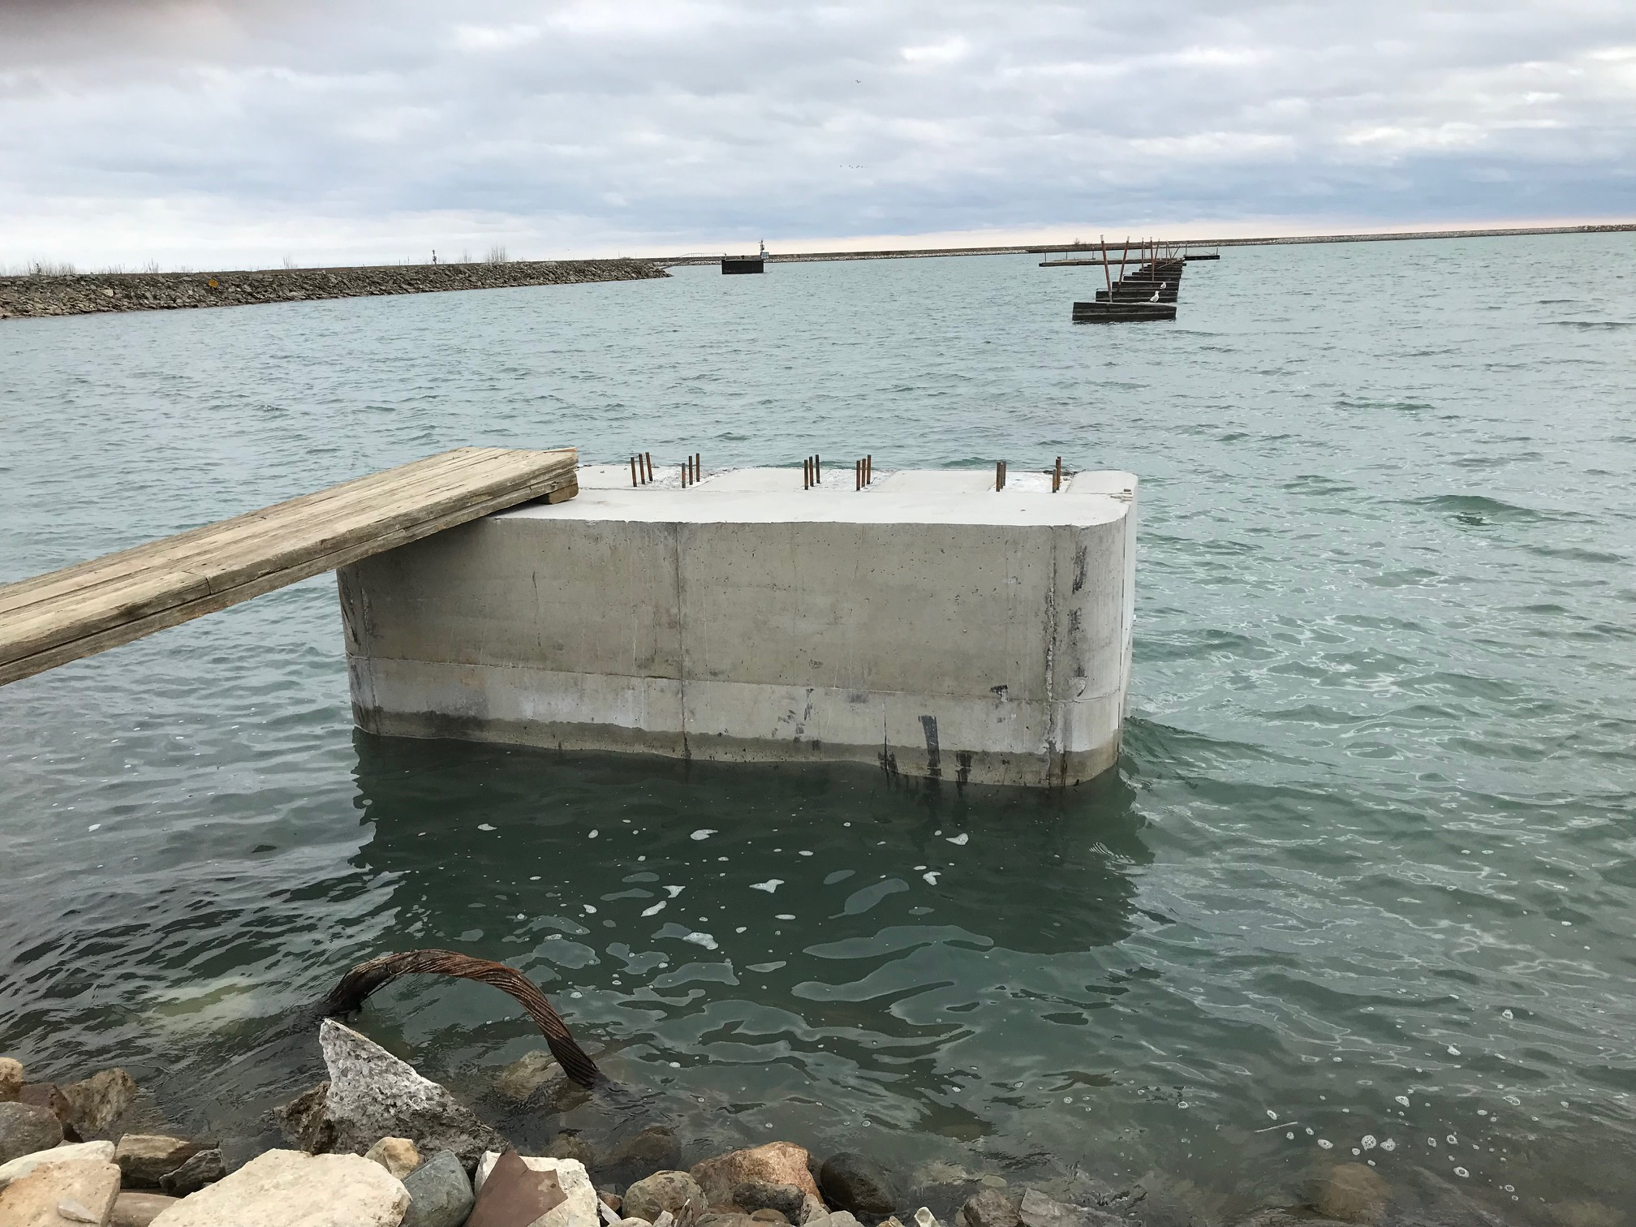
ReConstruction
After weathering a pandemic and high-water levels construction started in 2022.

Slide 7
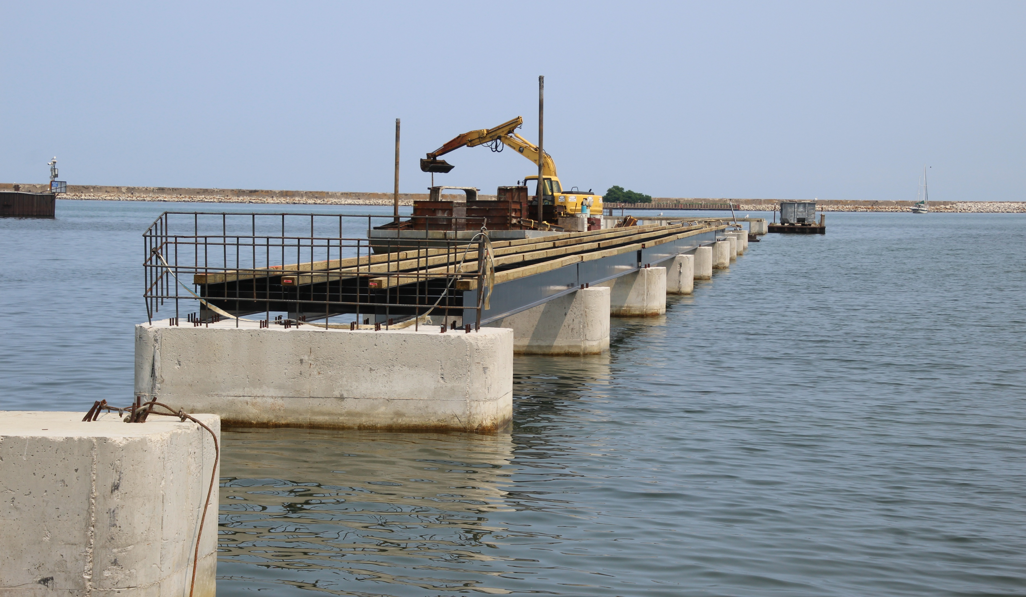
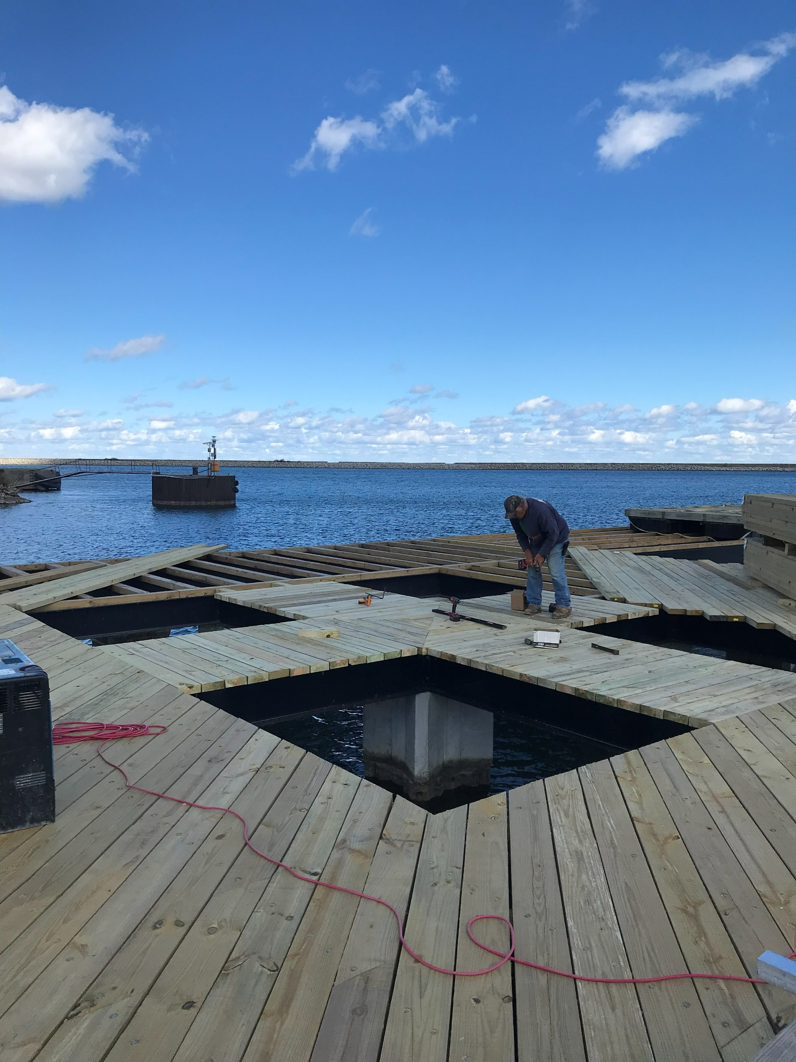
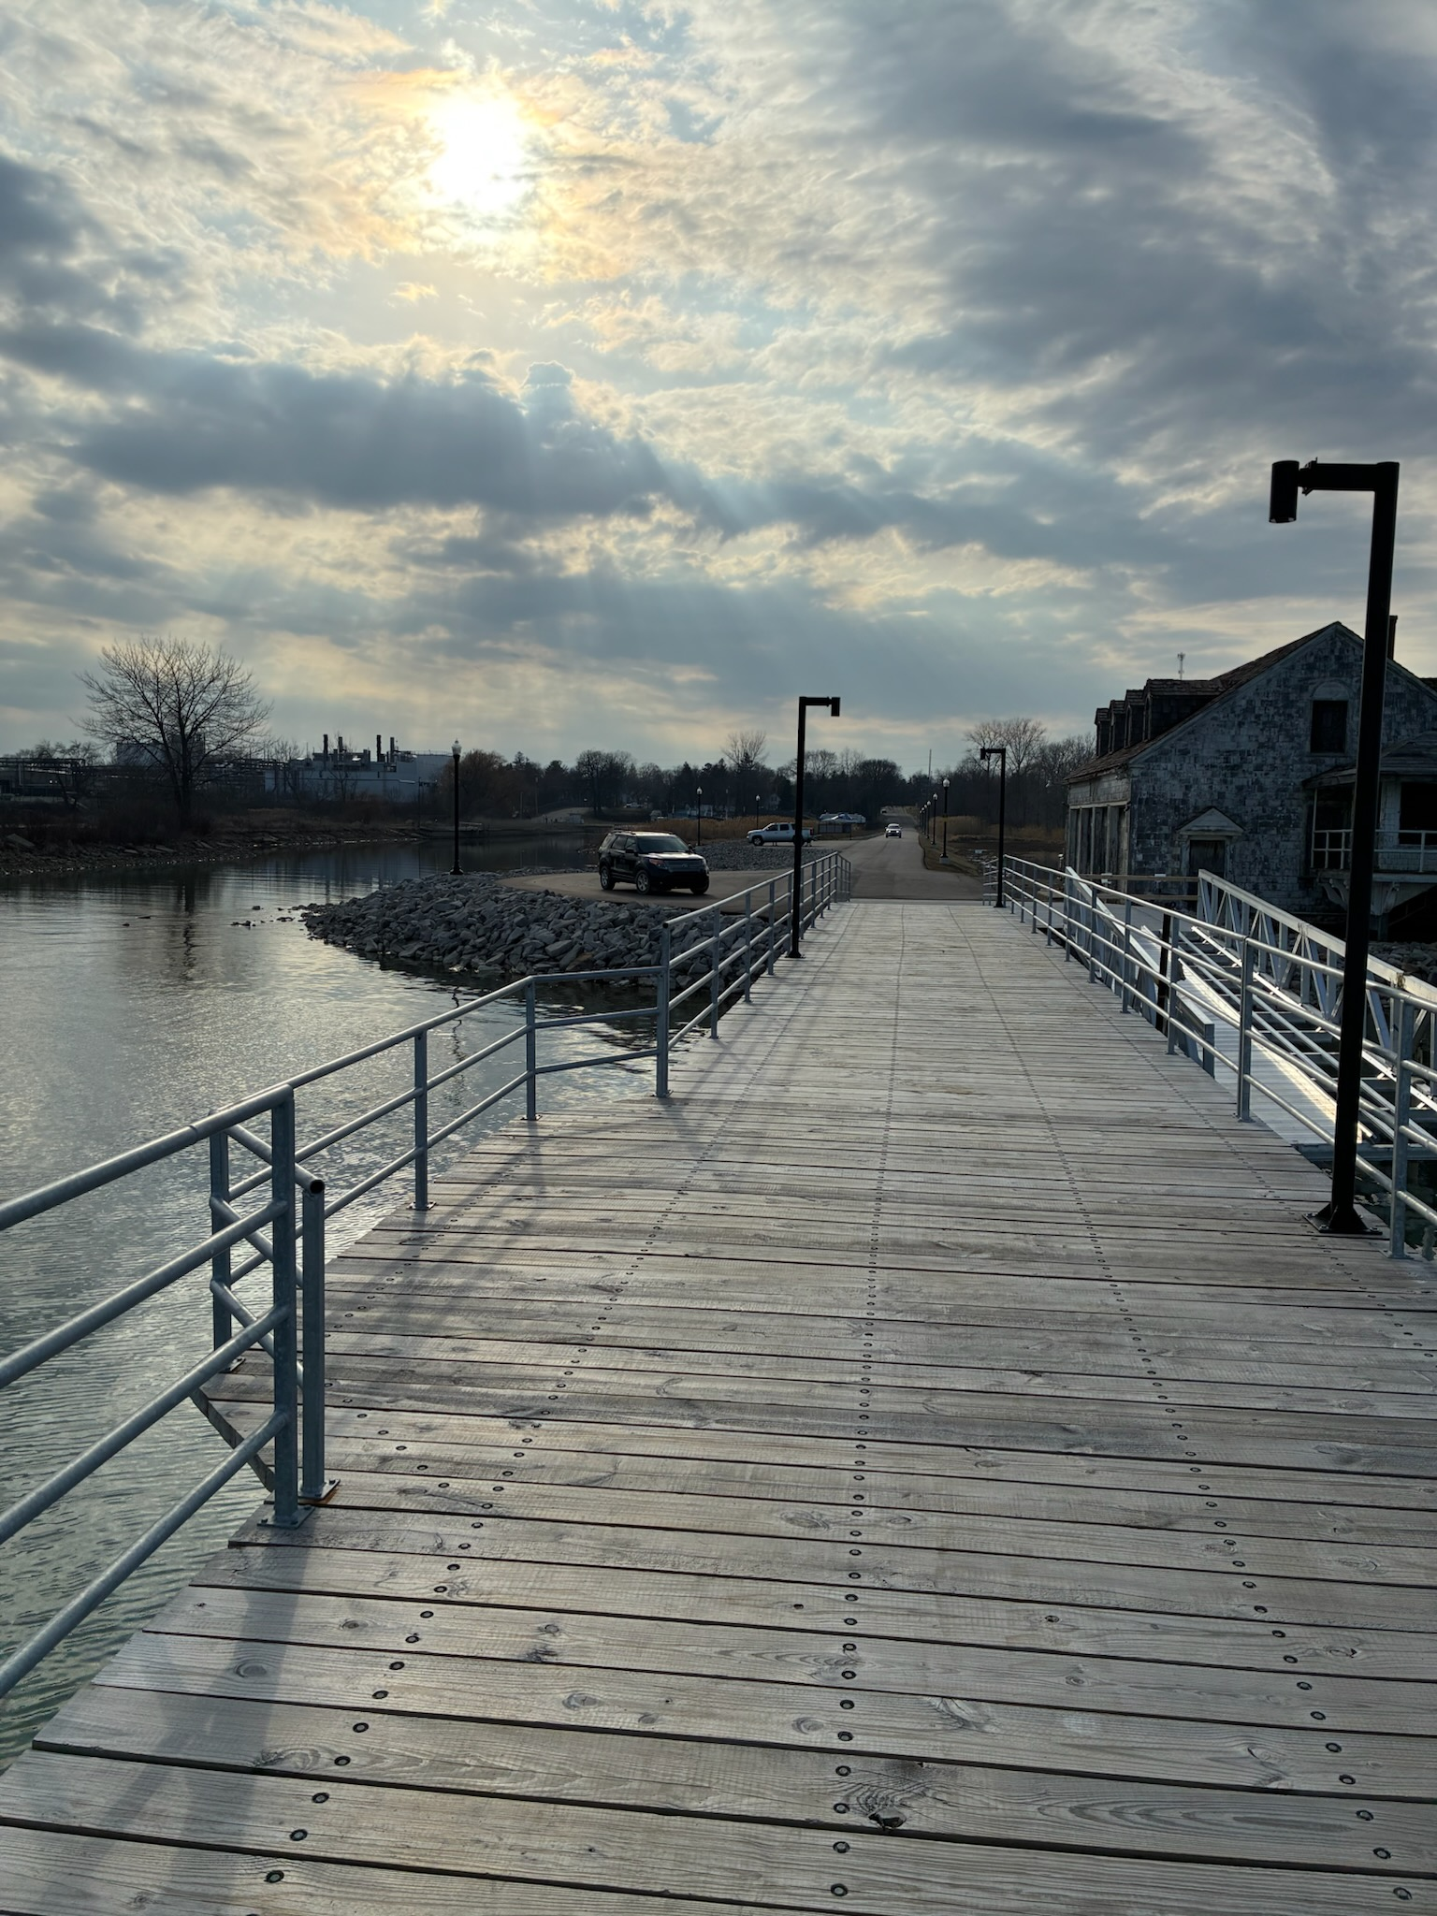
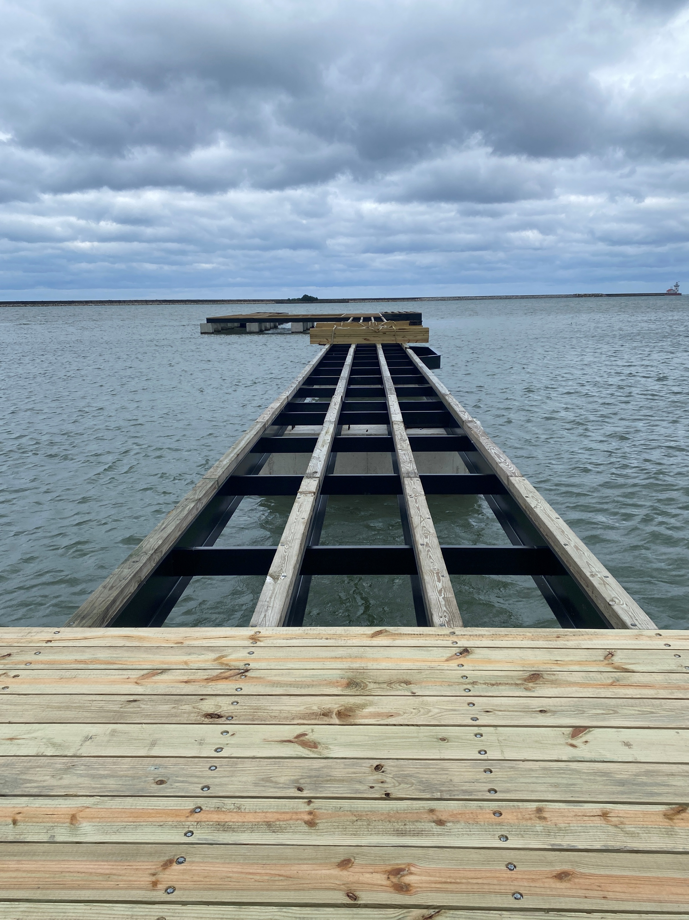
Planking the deck
The project was completed exclusively by City personnel and equipment, including a sectional barge owned by the City for dredging the City’s marina.

Slide 8
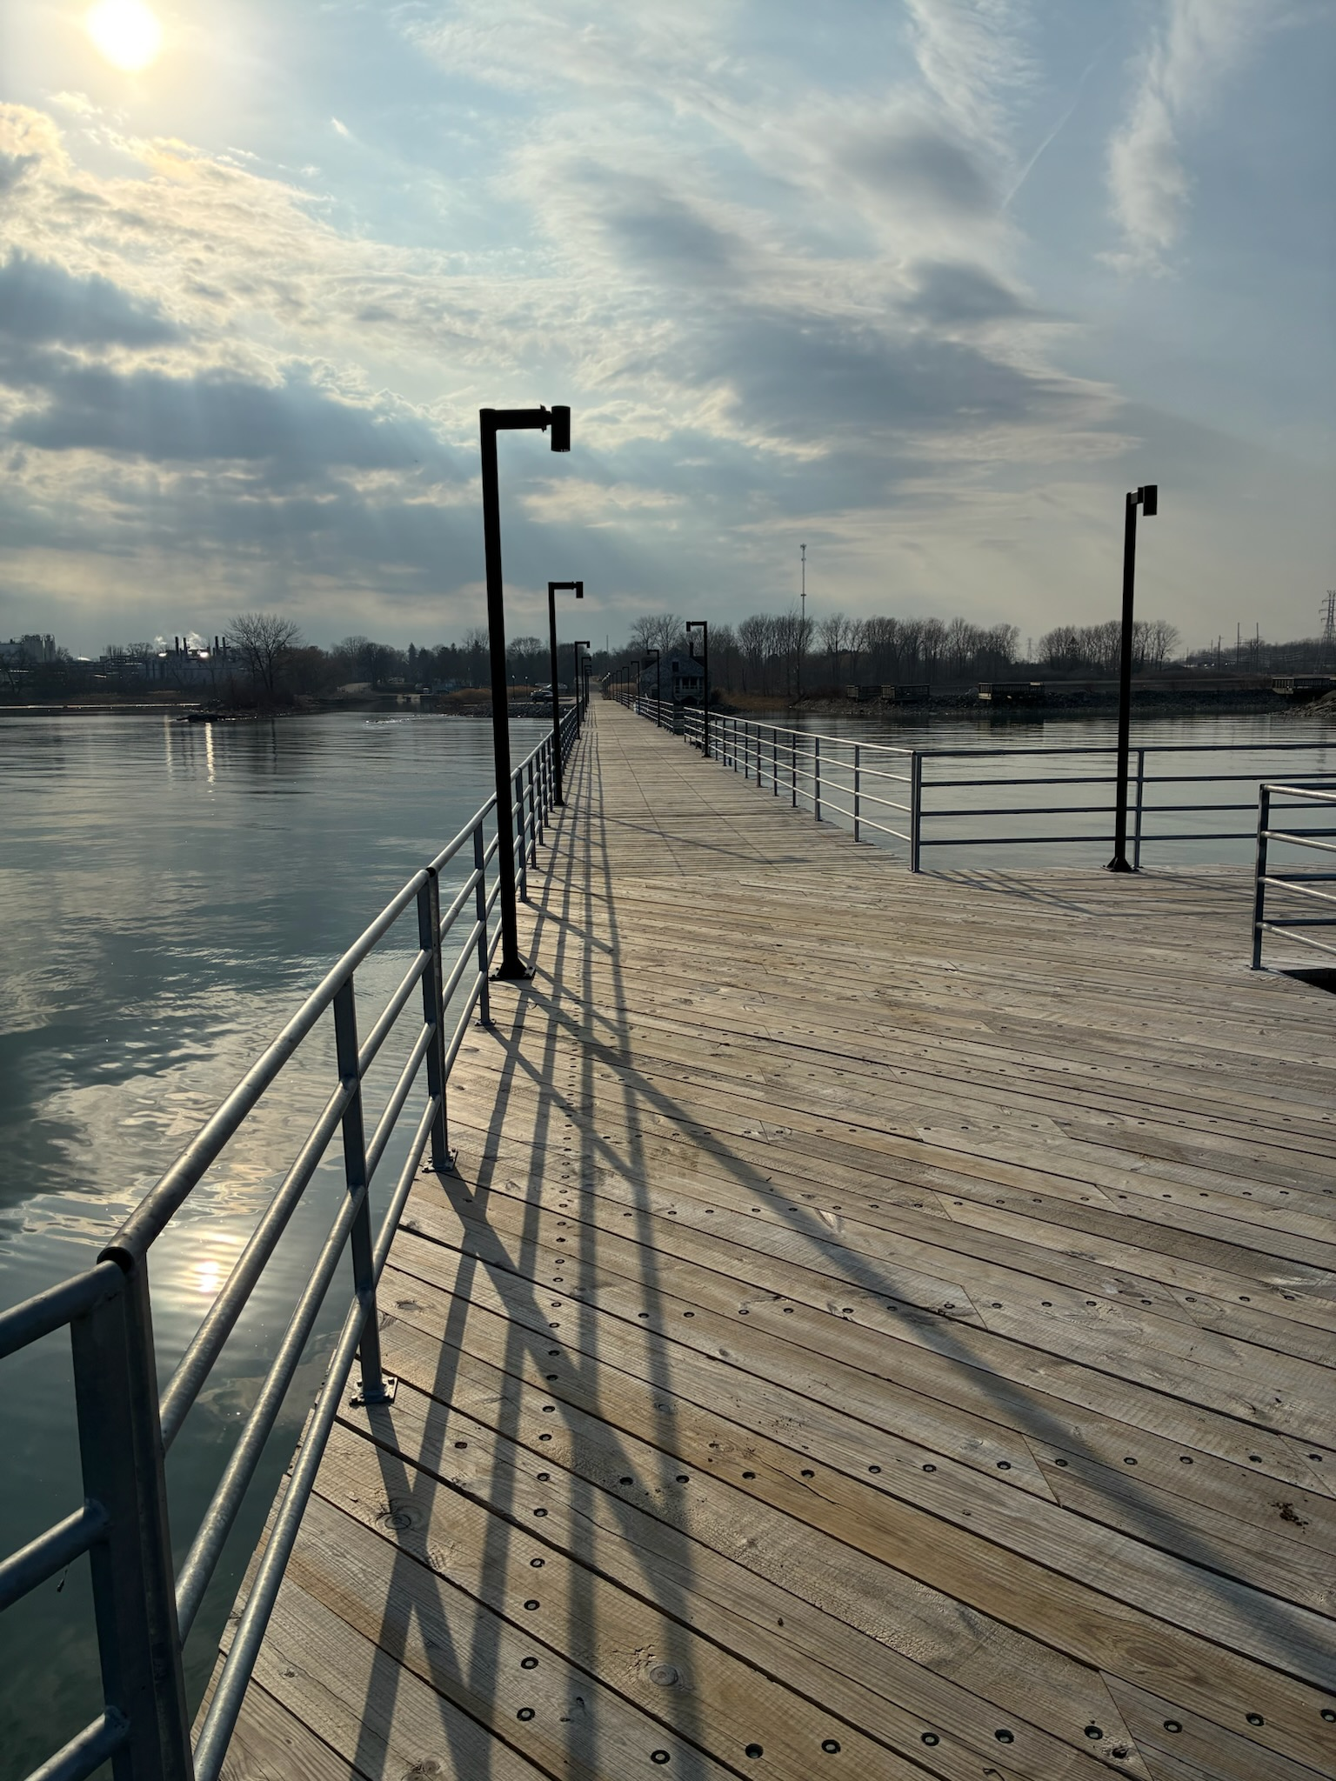
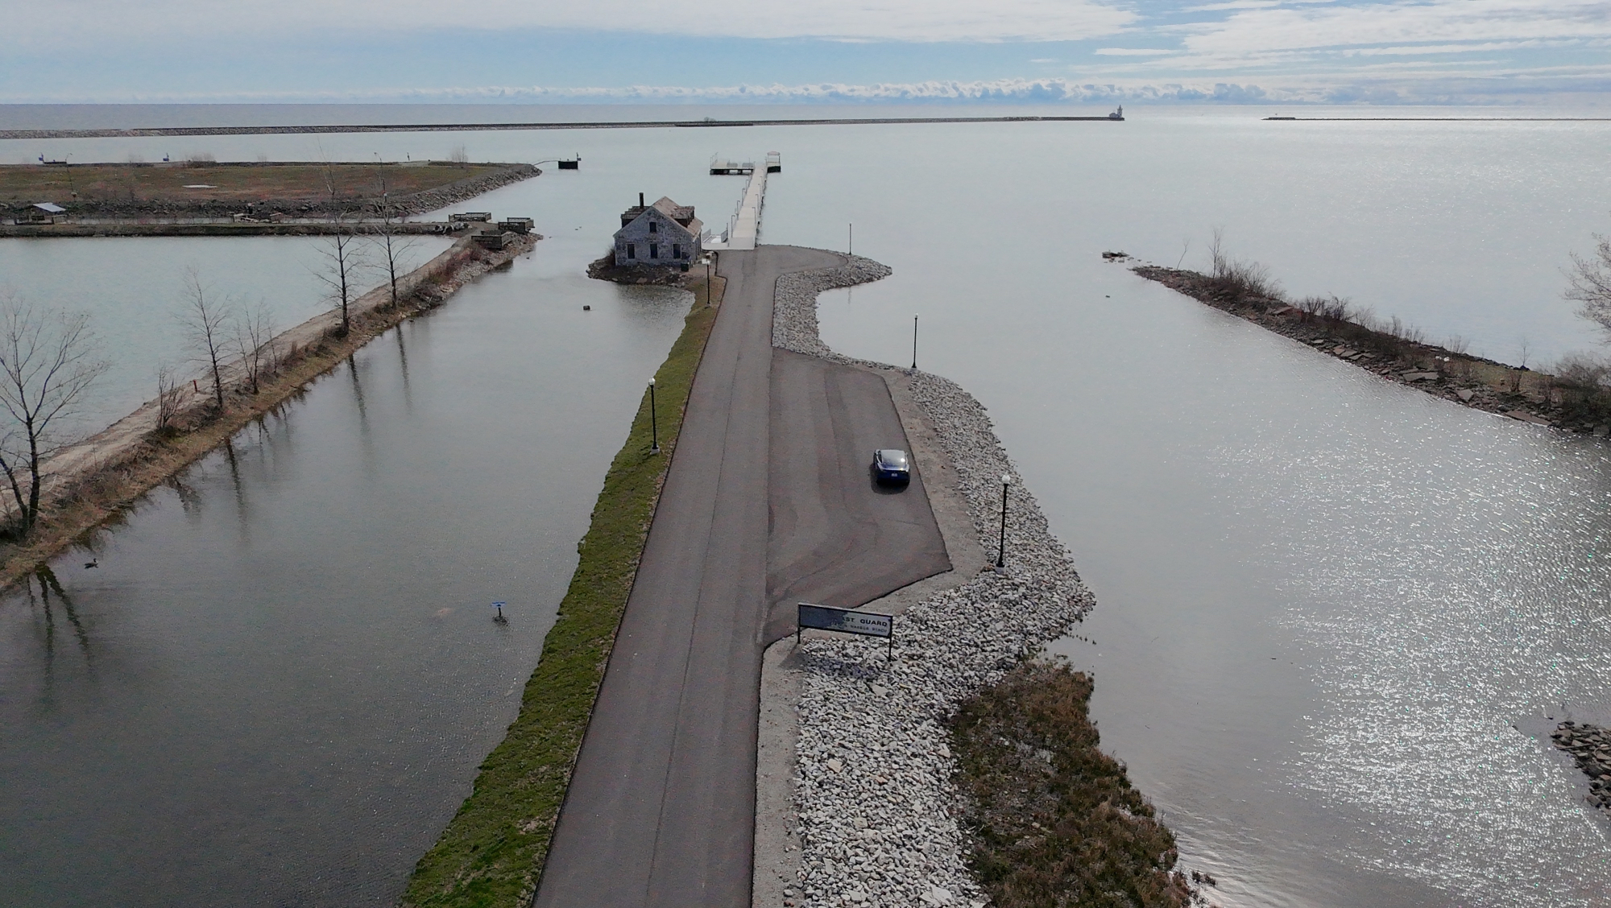
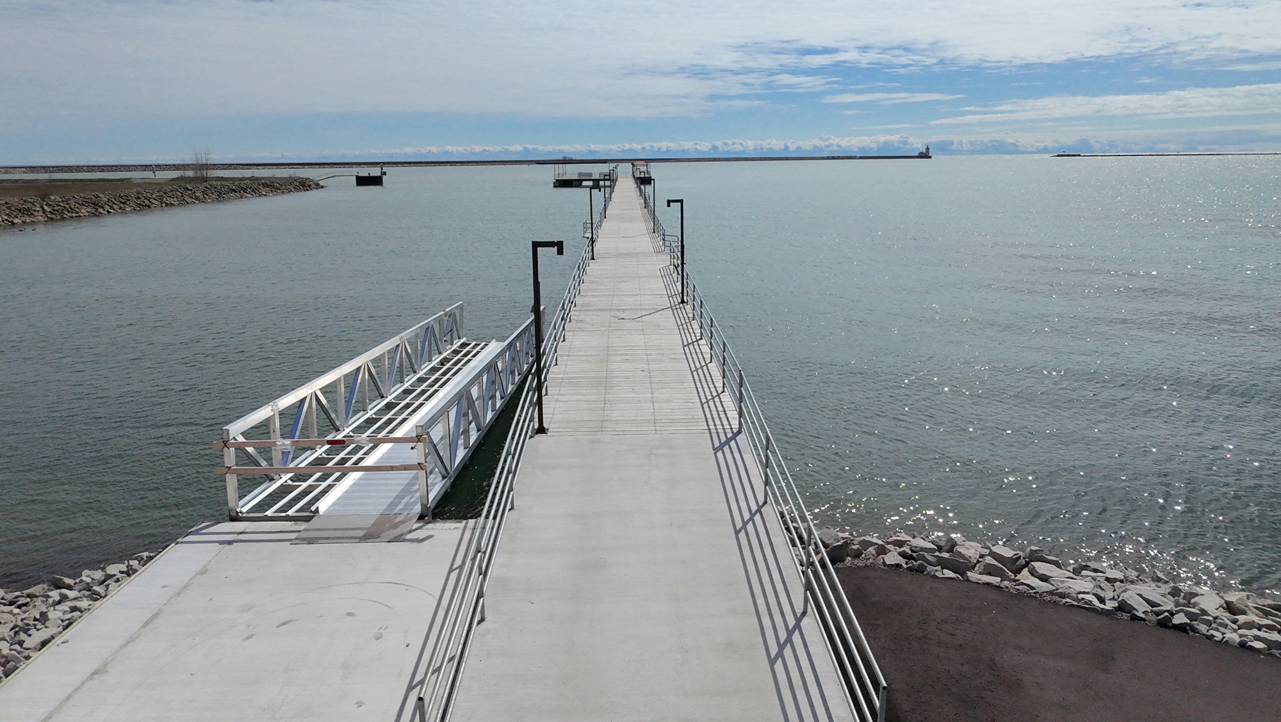
Reconstruction Complete
The pier is finished with lighting fishing bump outs, and an ADA kayak launch.

Slide 9
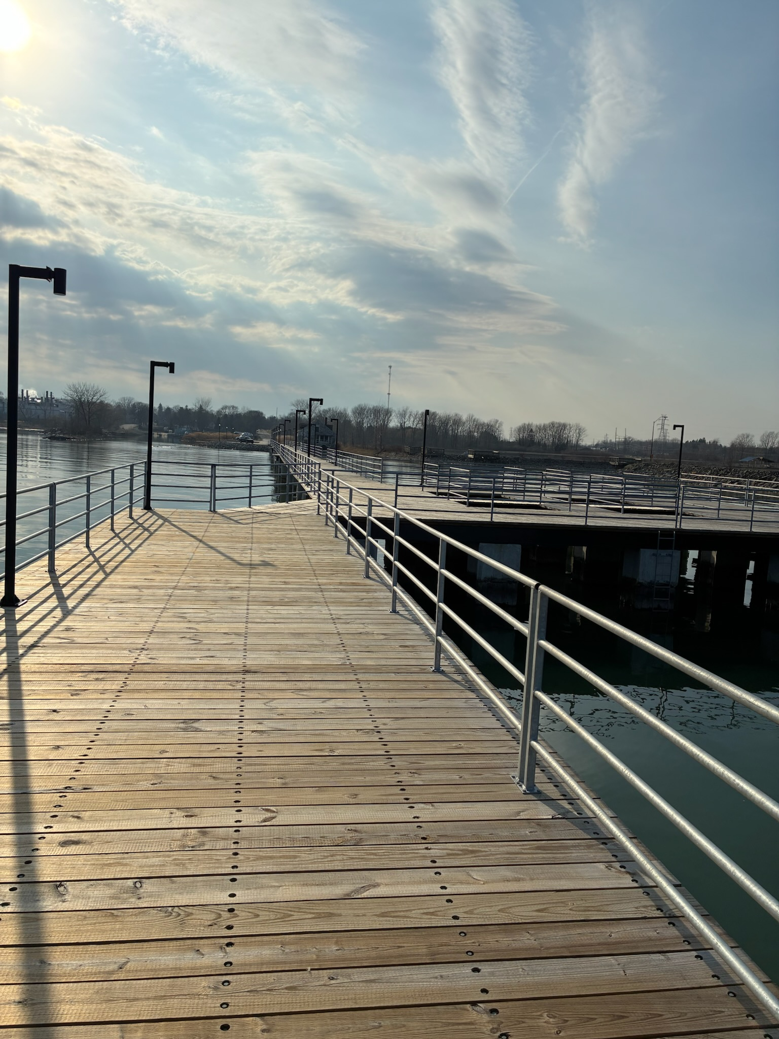
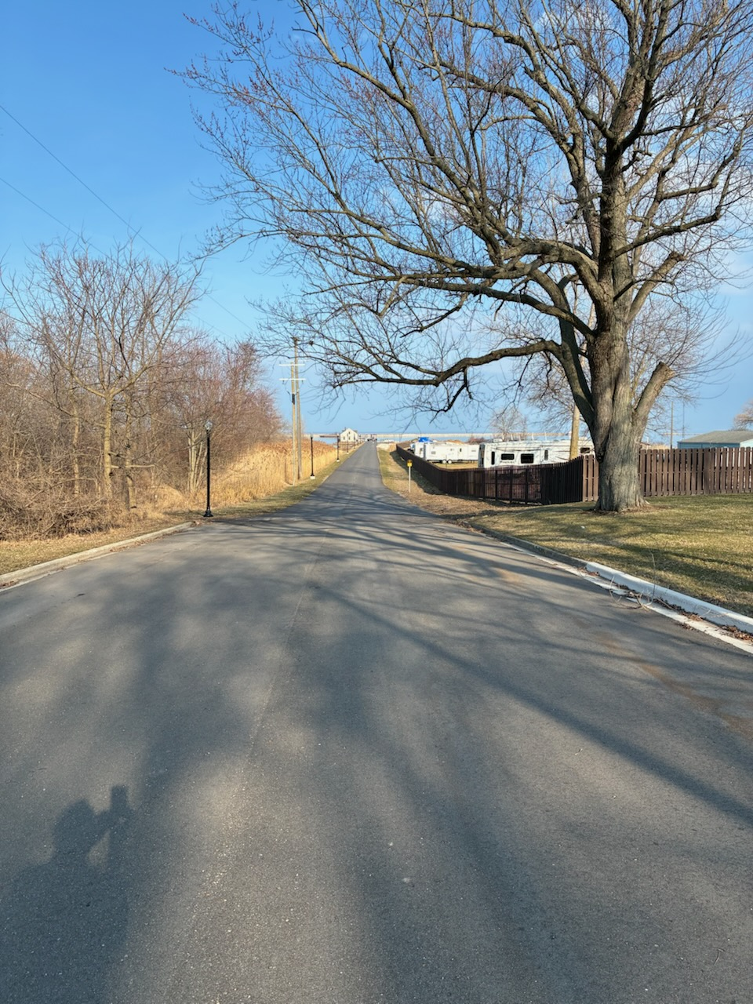
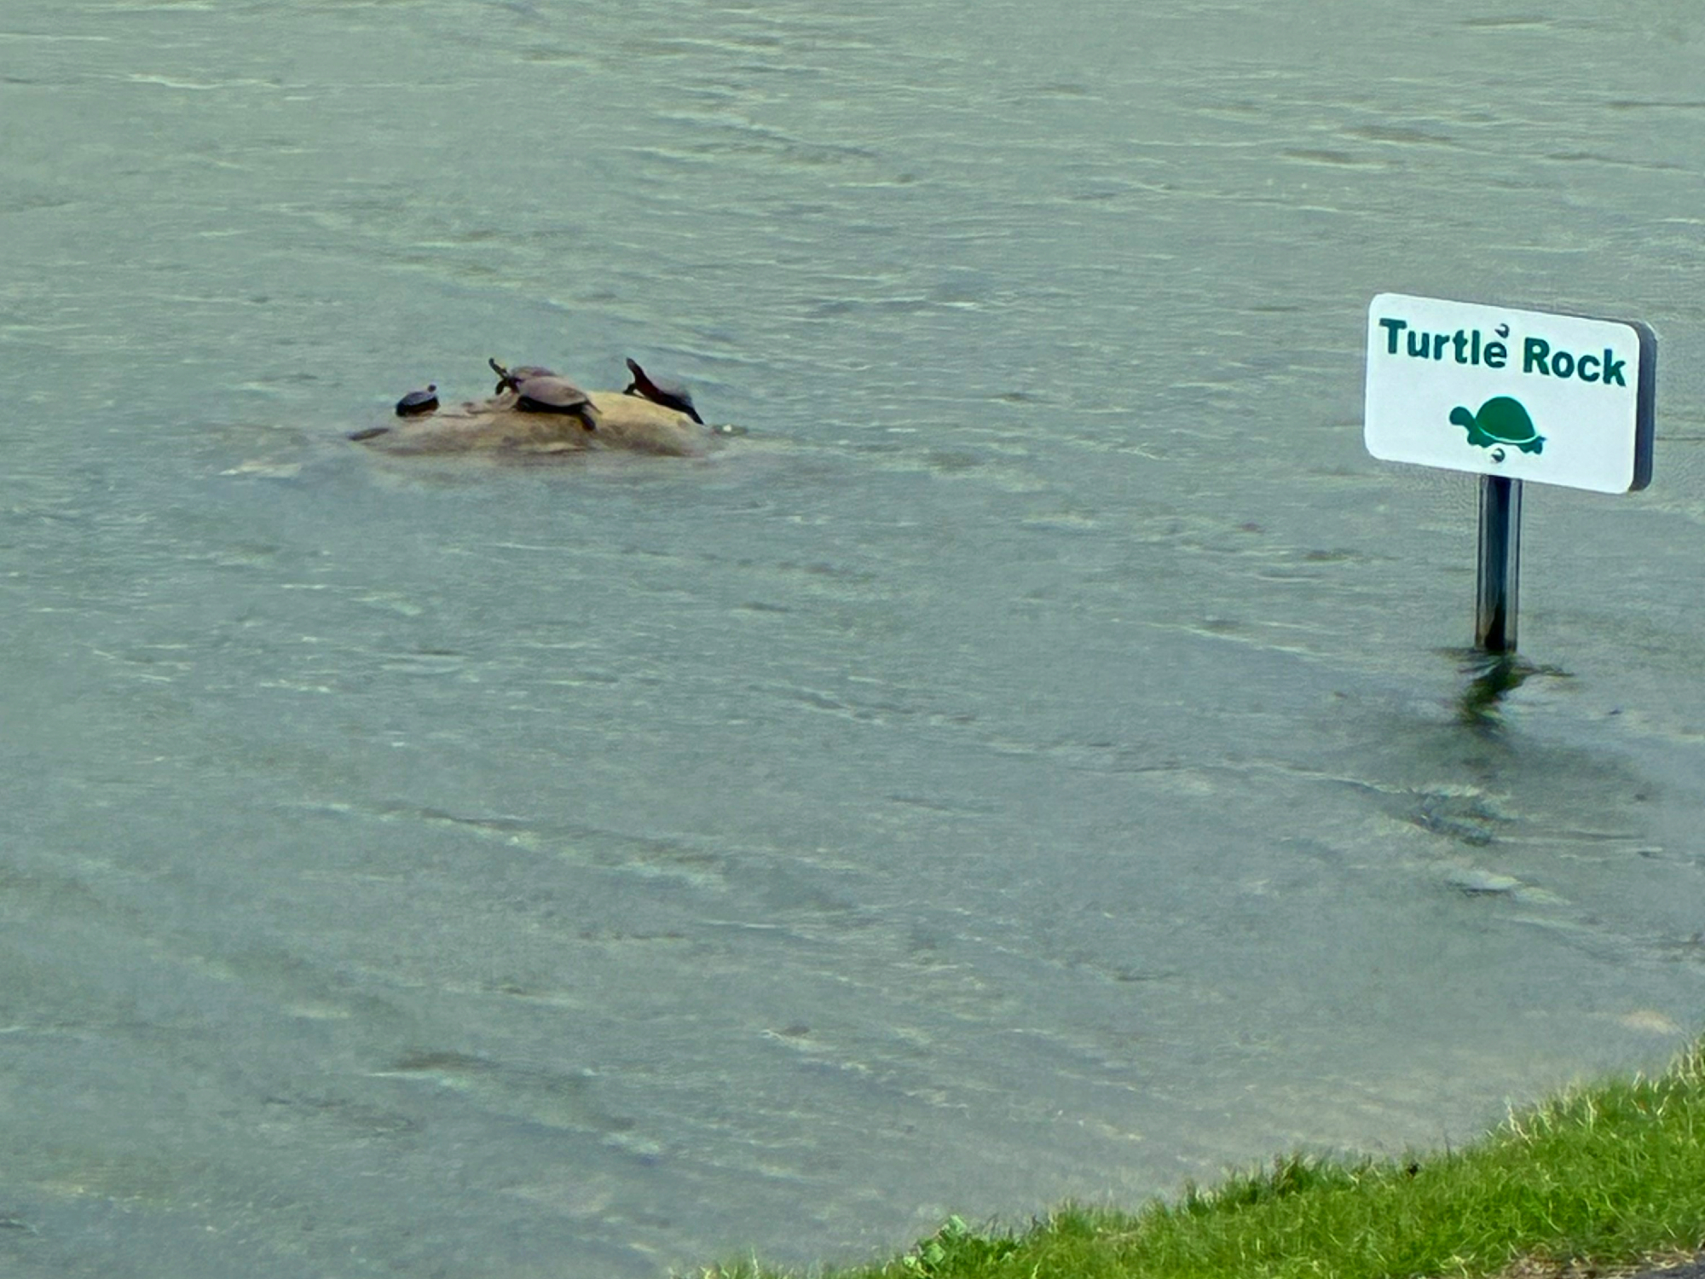
Reconstruction Complete continued
The pier can now accommodate fishing, walking, kayaking and a tremendous view of the sunrise and Lake Huron. Assess to the pier is via the newly paved road and bike/pedestrian path that connects to the City’s “Harbor View Trail”. As you walk, bike or ride out to the pier you’ll find turtles enjoying the sun on Turtle Rock.

Slide 10
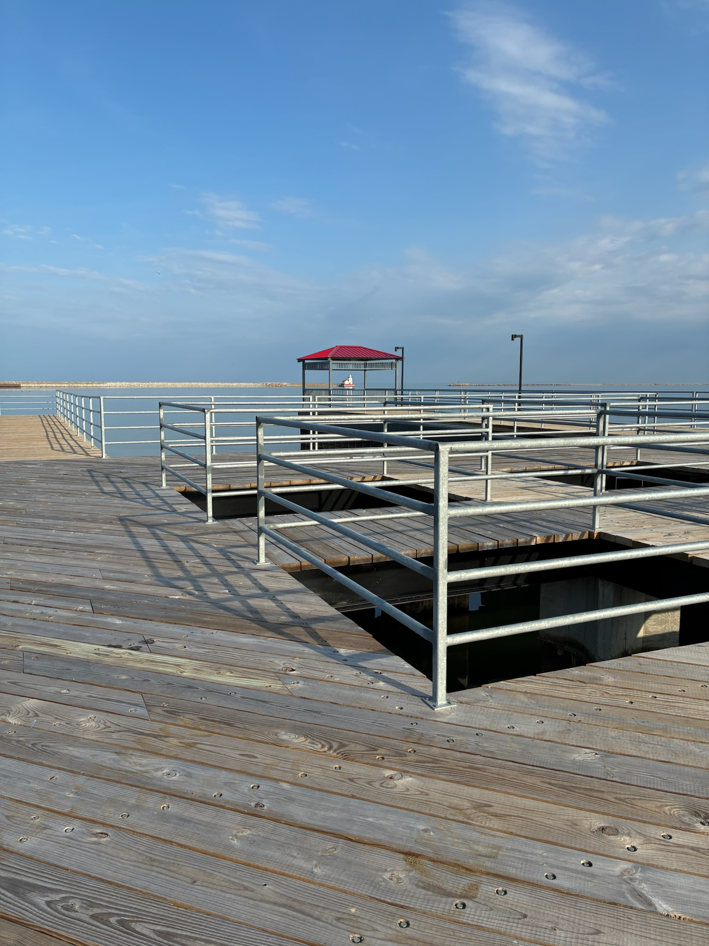
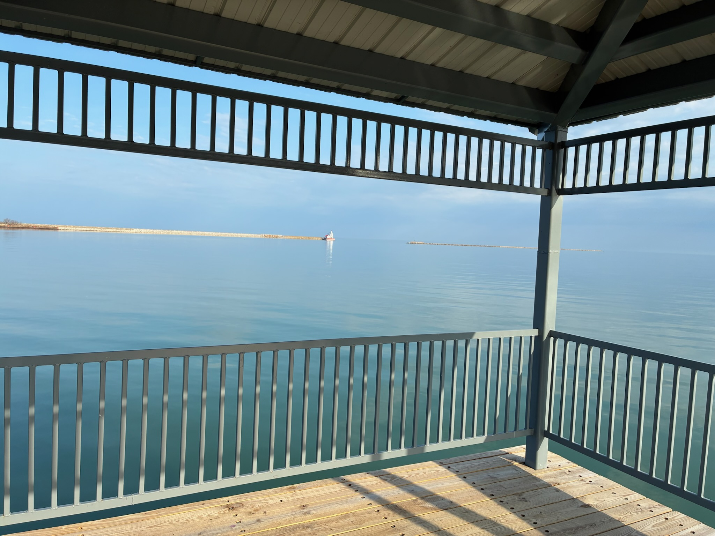
Gazebo – the Final touch
A gazebo was added to the end of the pier to offer a shaded area and a spot for a panoramic view of the City’s lighthouse, the Worlds Greatest Manmade Harbor” and Harbor Beach’s front door.

