Slide 1


Empowering residents
to achieve the lives they want
for themselves and their families.
www.kalamazooffe.org

Slide 2
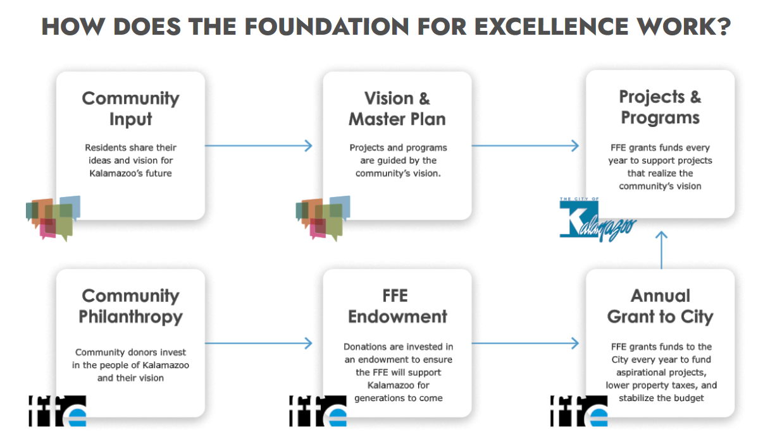

Slide 3
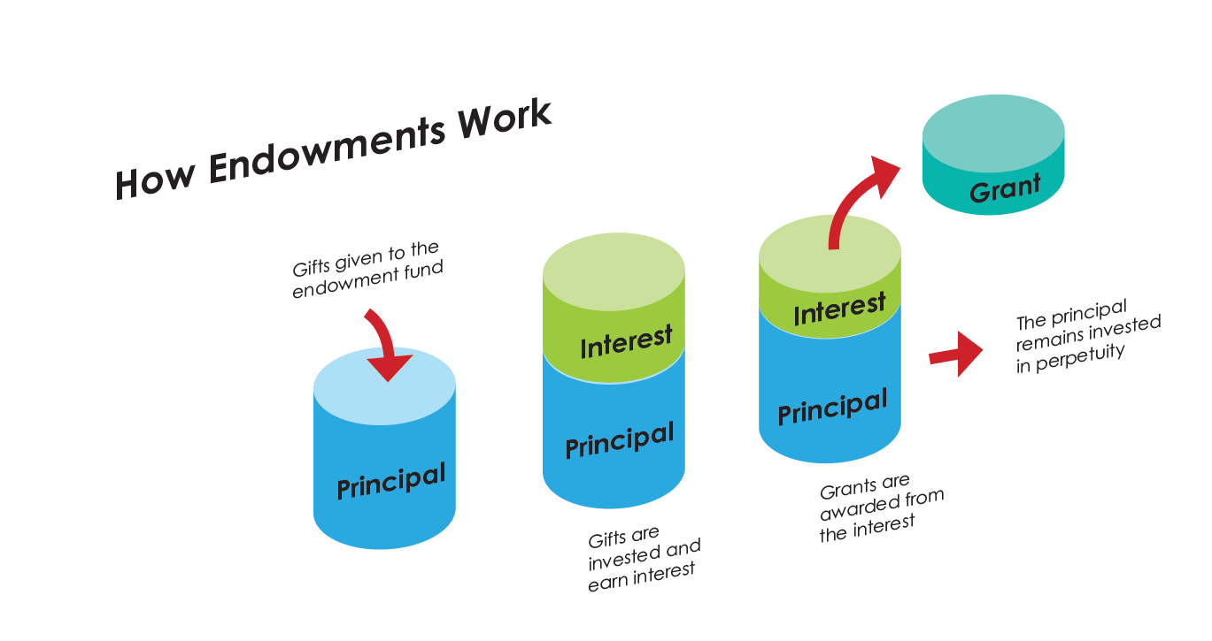

Slide 4
1.48% Avg Net Growth
Major Gifts
Complete
]
January
2026: Ahead of Target
COVID Impacts

Slide 5
FFE has invested
$220 million in Kalamazoo
since 2017 and plans
$483 million more by 2040.
It will exist in perpetuity.

Slide 6
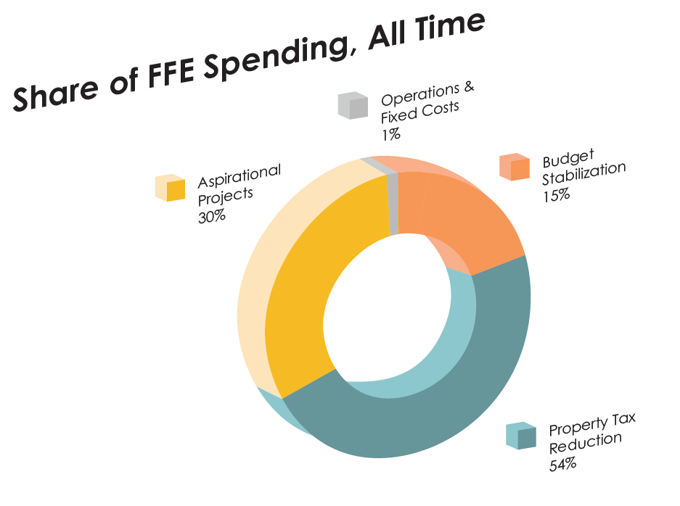
$0.987
of every dollar
FFE has spent
has gone to impact.
Notes:
Aspirational is estimated to be 1-3% of philanthropy in the city

Slide 7
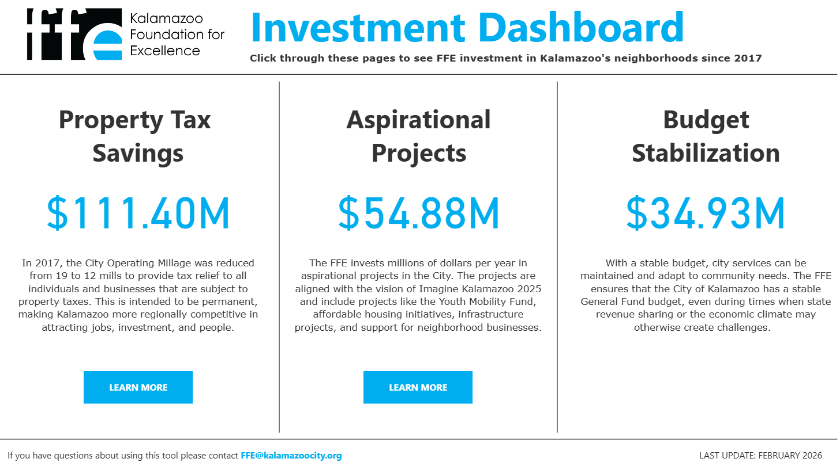
Notes:
Brown
In addition to Goal alignment it is just as important to align FFE aspirational investments with the right geographies and people in Kalamazoo.
The innovative Investment Map that is public to everyone via Kalamazoocity.org allows people to see investments to the dollar by year, neighborhood, Goal, and project name.
The darkest blue areas of this map clearly show that the neighborhoods most in need of FFE investment due to historic disinvestment or exclusion are the ones receiving it.

Slide 8
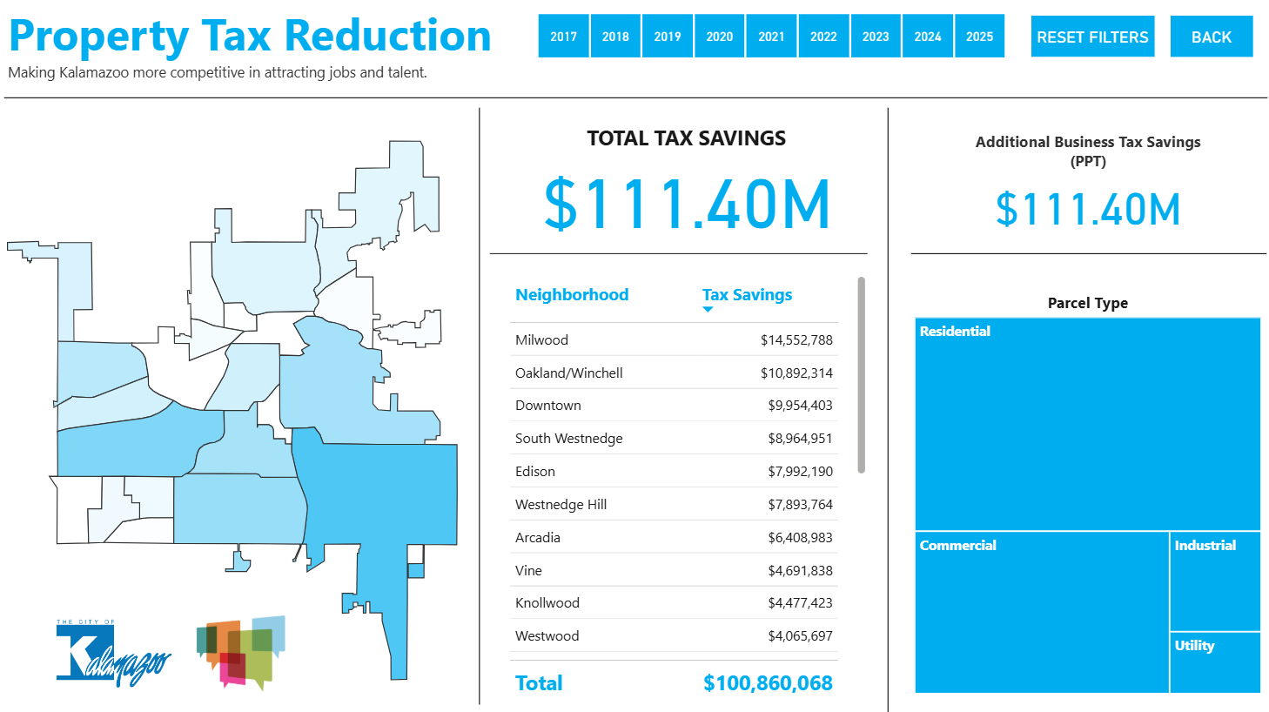

Slide 9
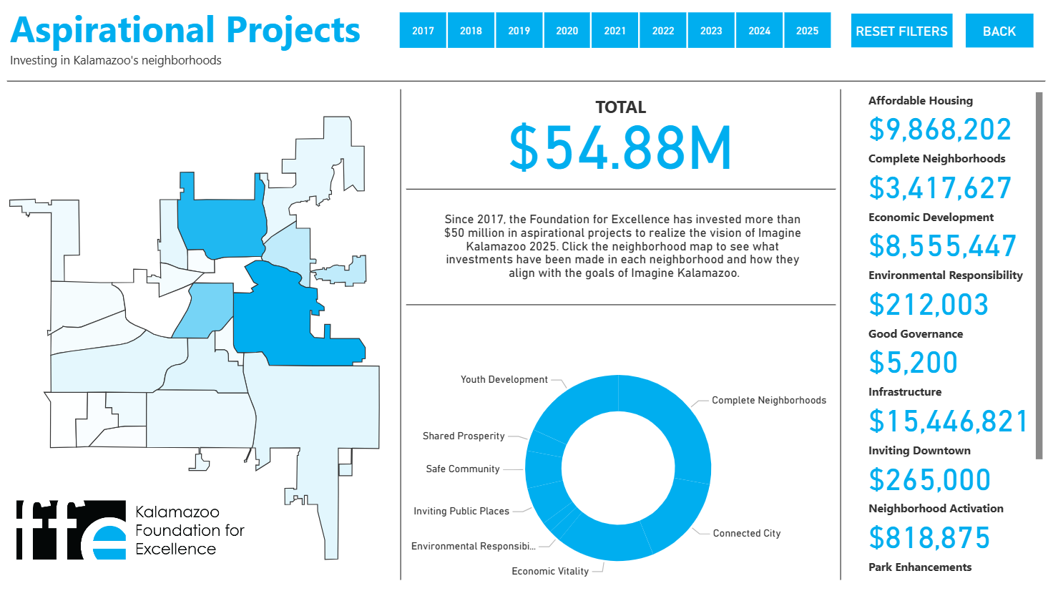
Notes:
Brown
In addition to Goal alignment it is just as important to align FFE aspirational investments with the right geographies and people in Kalamazoo.
The innovative Investment Map that is public to everyone via Kalamazoocity.org allows people to see investments to the dollar by year, neighborhood, Goal, and project name.
The darkest blue areas of this map clearly show that the neighborhoods most in need of FFE investment due to historic disinvestment or exclusion are the ones receiving it.

Slide 10
Aspirational in Core Neighborhoods
Core Neighborhoods: at least 51% of households have incomes at or below 80% of the area median income and are prioritized for community development and planning initiatives, acting as the residential, cultural, and historic heart of the city surrounding downtown.
Notes:
Brown
In addition to Goal alignment it is just as important to align FFE aspirational investments with the right geographies and people in Kalamazoo.
The innovative Investment Map that is public to everyone via Kalamazoocity.org allows people to see investments to the dollar by year, neighborhood, Goal, and project name.
The darkest blue areas of this map clearly show that the neighborhoods most in need of FFE investment due to historic disinvestment or exclusion are the ones receiving it.

