Slide 1
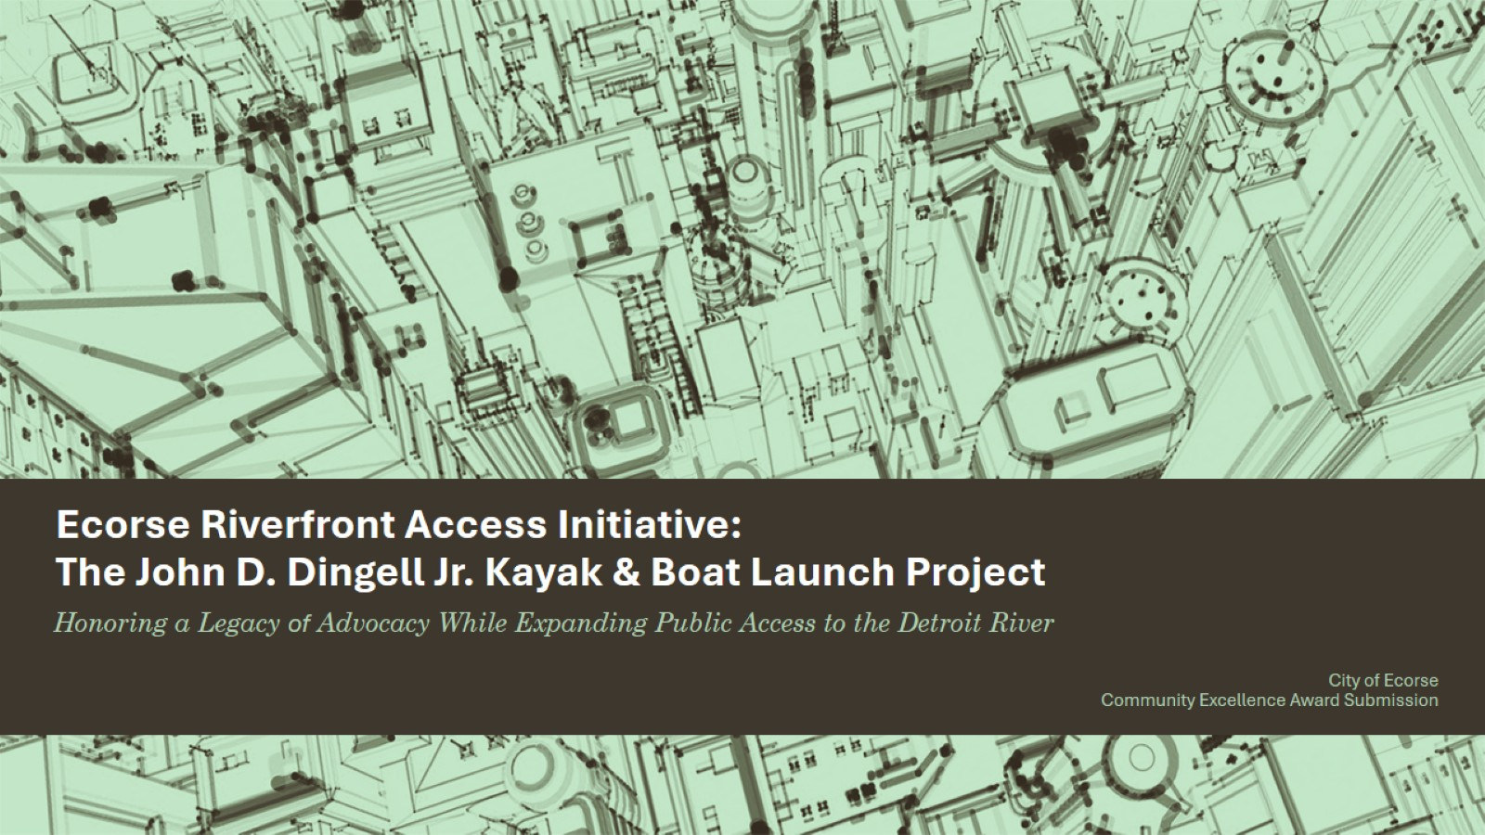
Ecorse Riverfront Access Initiative:
The John D. Dingell Jr. Kayak & Boat Launch Project

Slide 2
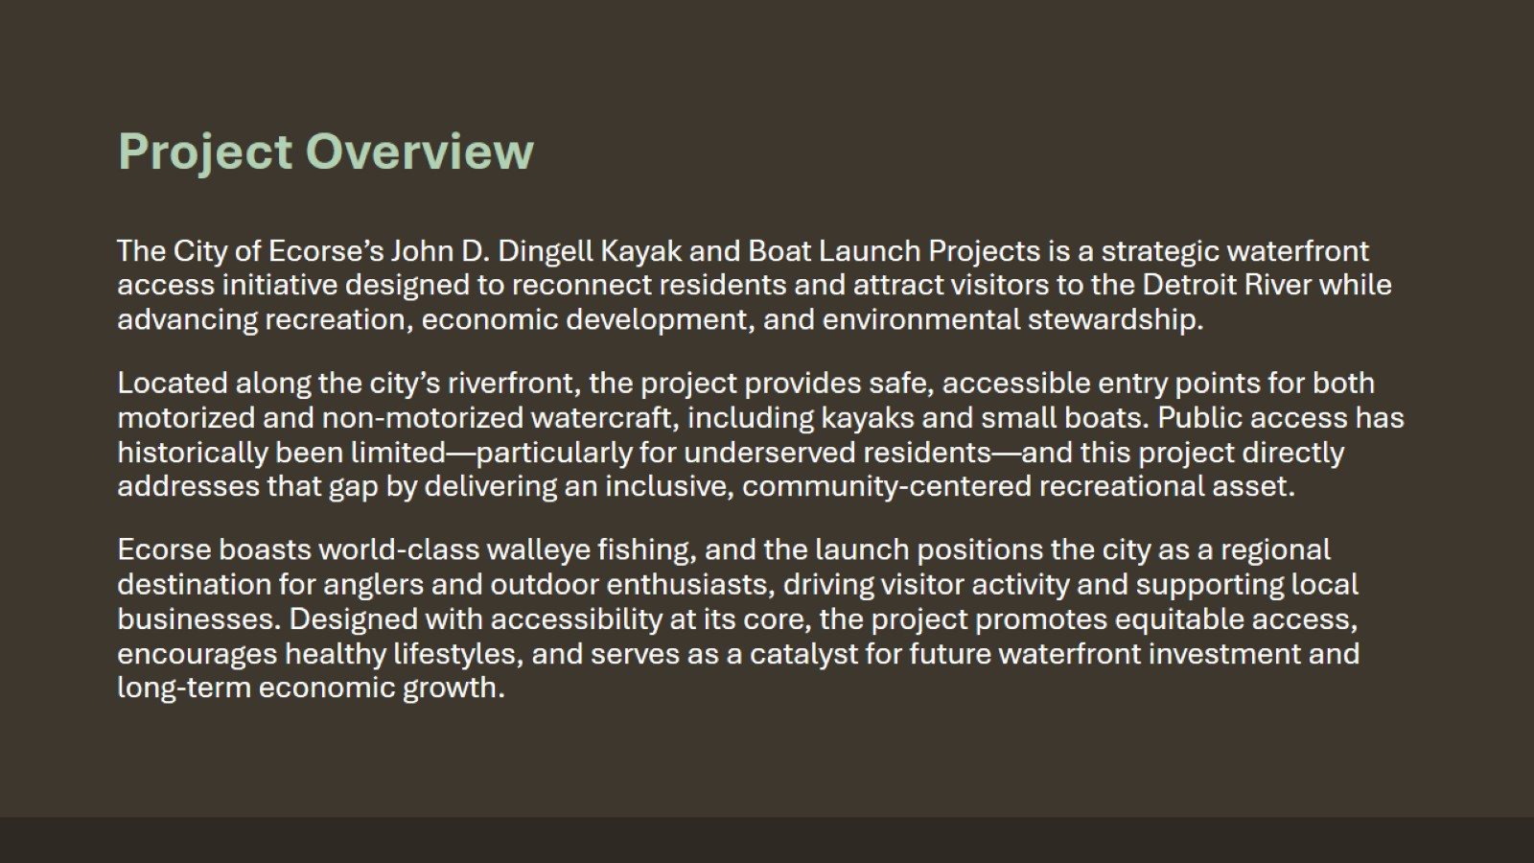
Project Overview

Slide 3
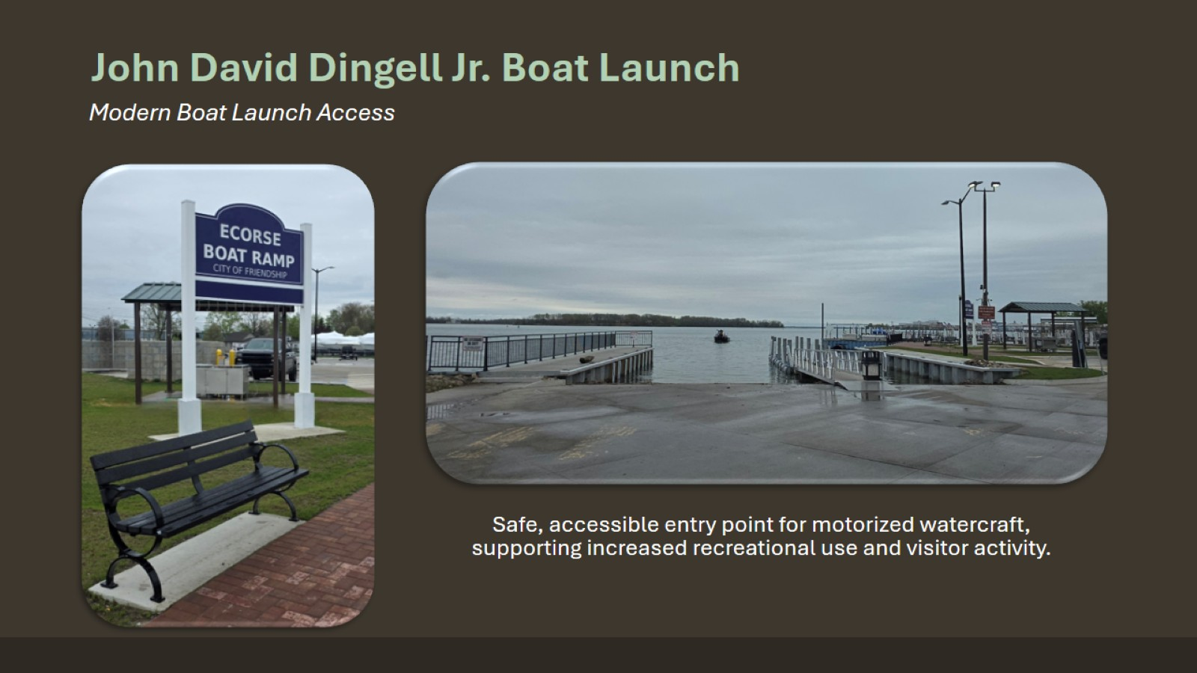
John David Dingell Jr. Boat Launch

Slide 4
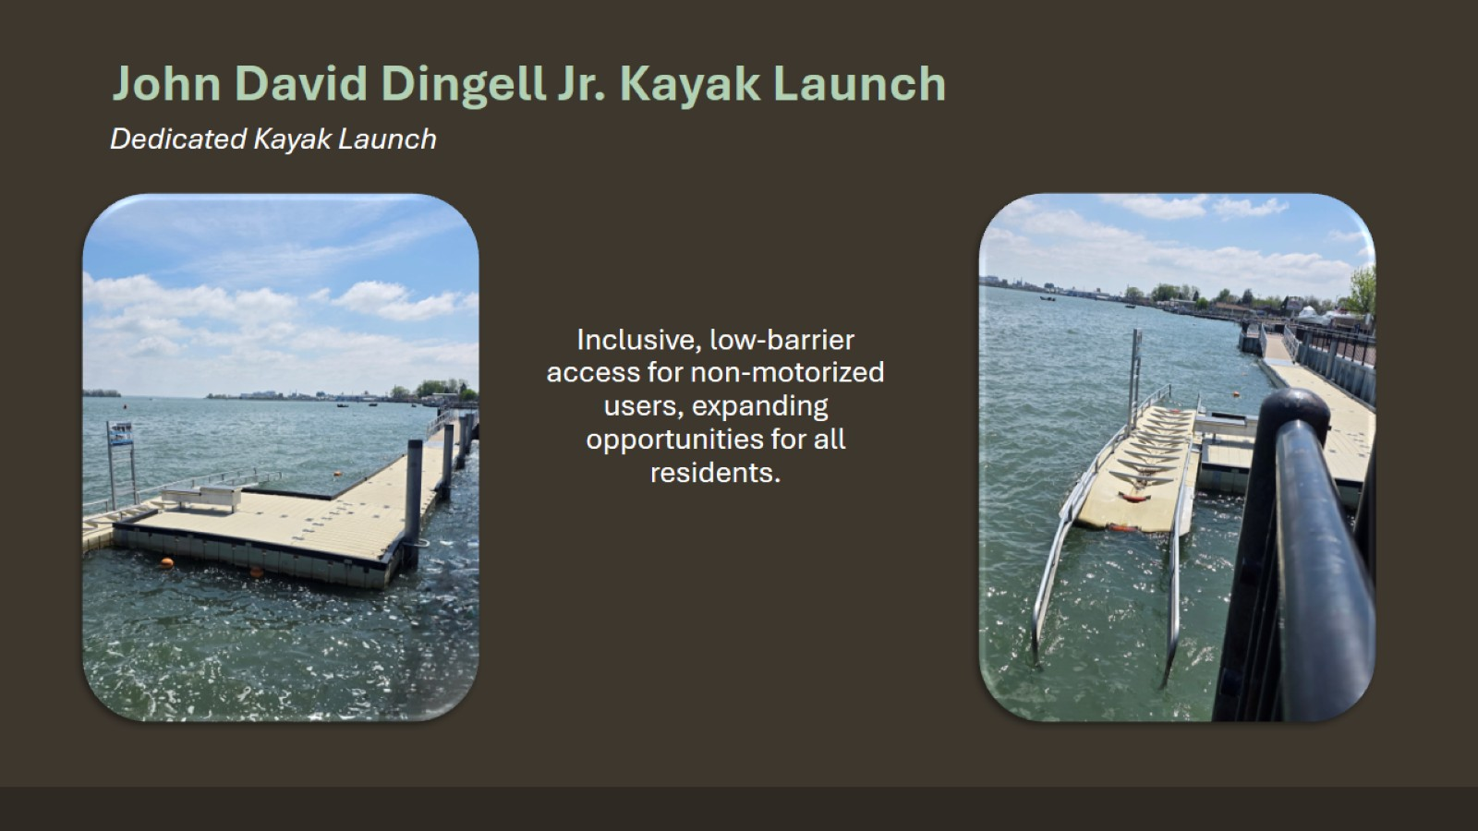
John David Dingell Jr. Kayak Launch

Slide 5
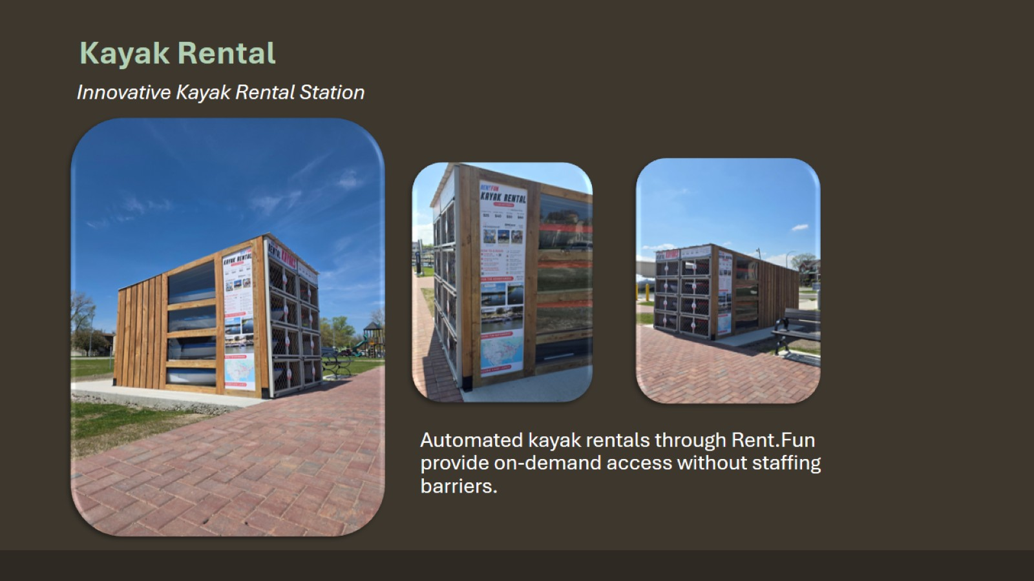
Kayak Rental

Slide 6
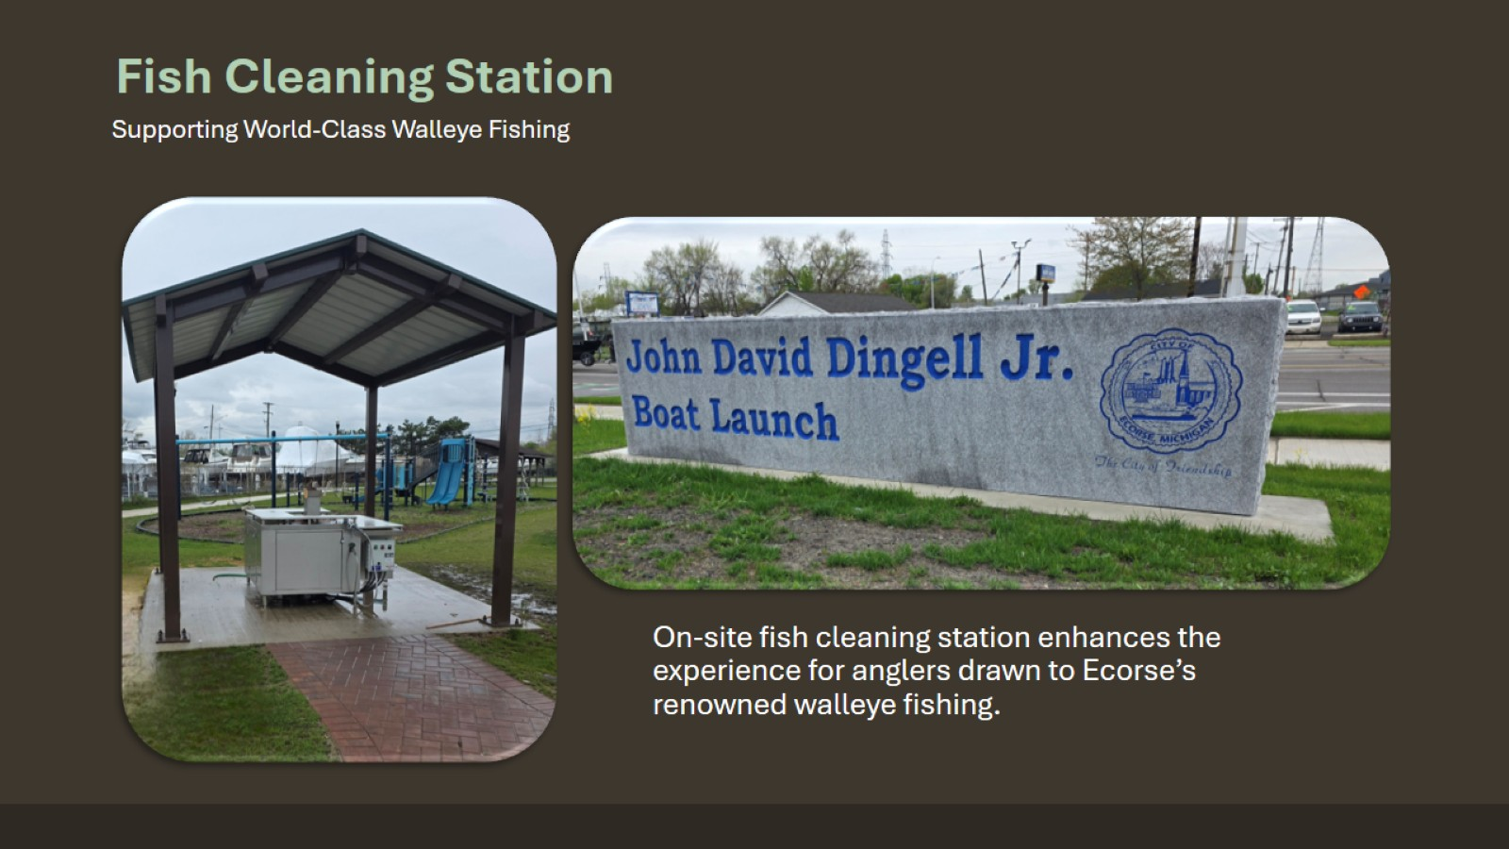

Slide 7
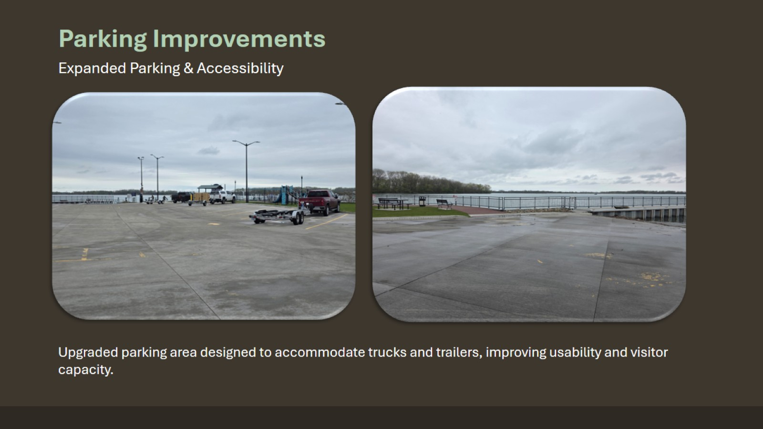

Slide 8
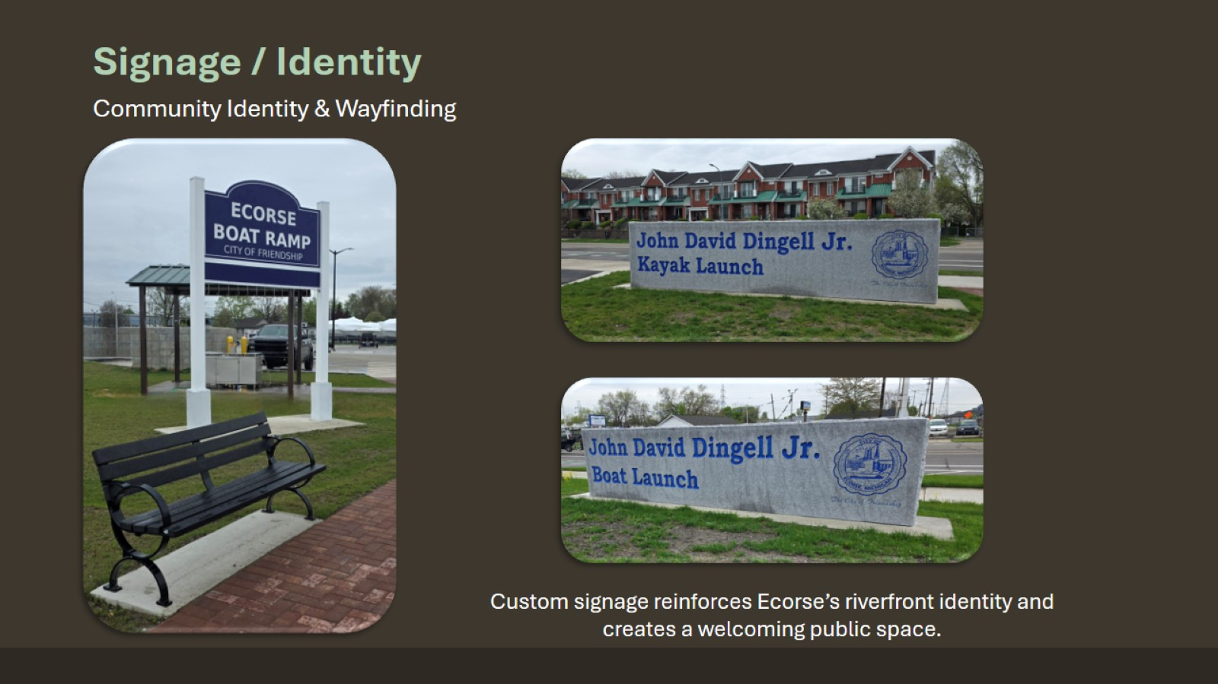

Slide 9
